Slide 1
Oscillations Core GReP workshop 2
Define the Q-value of an oscillator and explain how this relates to variations in current in an oscillating LC circuit.
How would you increase the Q-value of a circuit without changing its resonant frequency?
How does the rate of power dissipation change as the Q-value is increased for (a) a damped SHO, (b) a forced, damped SHO, (c) your LCR circuit?
The width of the resonance curve Δω at resonant frequency ω₀ in a circuit with quality factor Q is given by
(a) ω₀ (b) Qω₀ (c) ω₀/Q ?
How can you explain this result?
Two capacitors C₁ and C₂ are connected in series. What is the overall capacitance? What is the capacitance if instead they are connected in parallel?

Slide 2
Define the Q-value of an oscillator and explain how this relates to variations in current in an oscillating LC circuit.

Slide 3
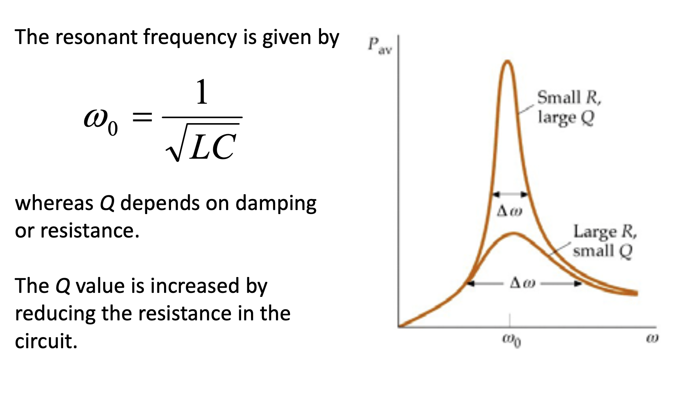
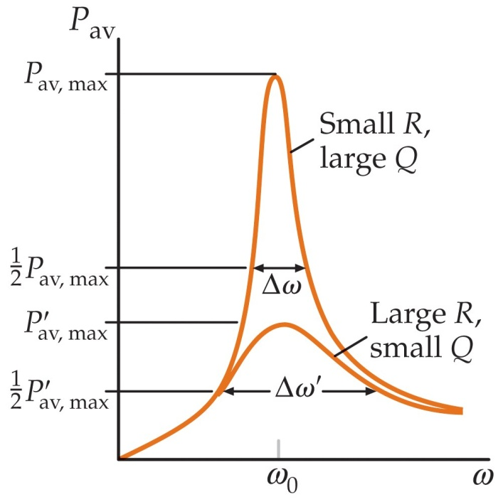
How would you increase the Q-value of a circuit without changing its resonant frequency?

Slide 4
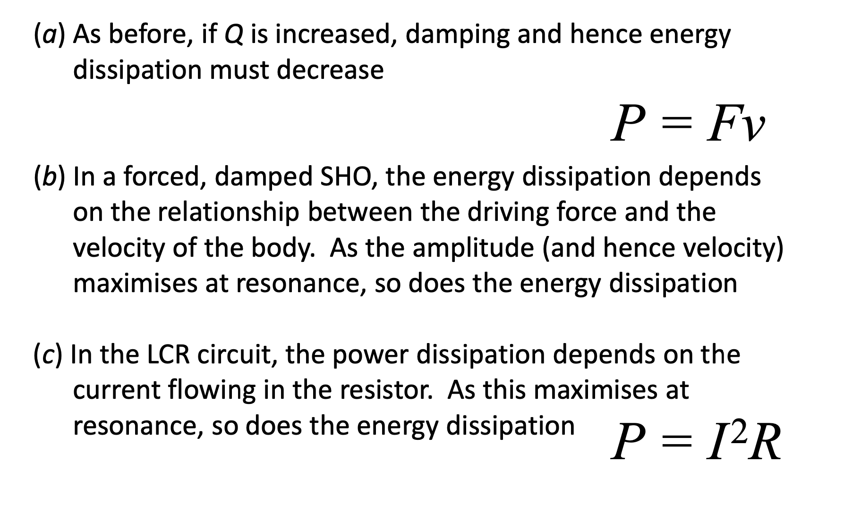
How does the rate of power dissipation change as the Q-value is increased for (a) a damped SHO, (b) a forced, damped SHO, (c) your LCR circuit?

Slide 5
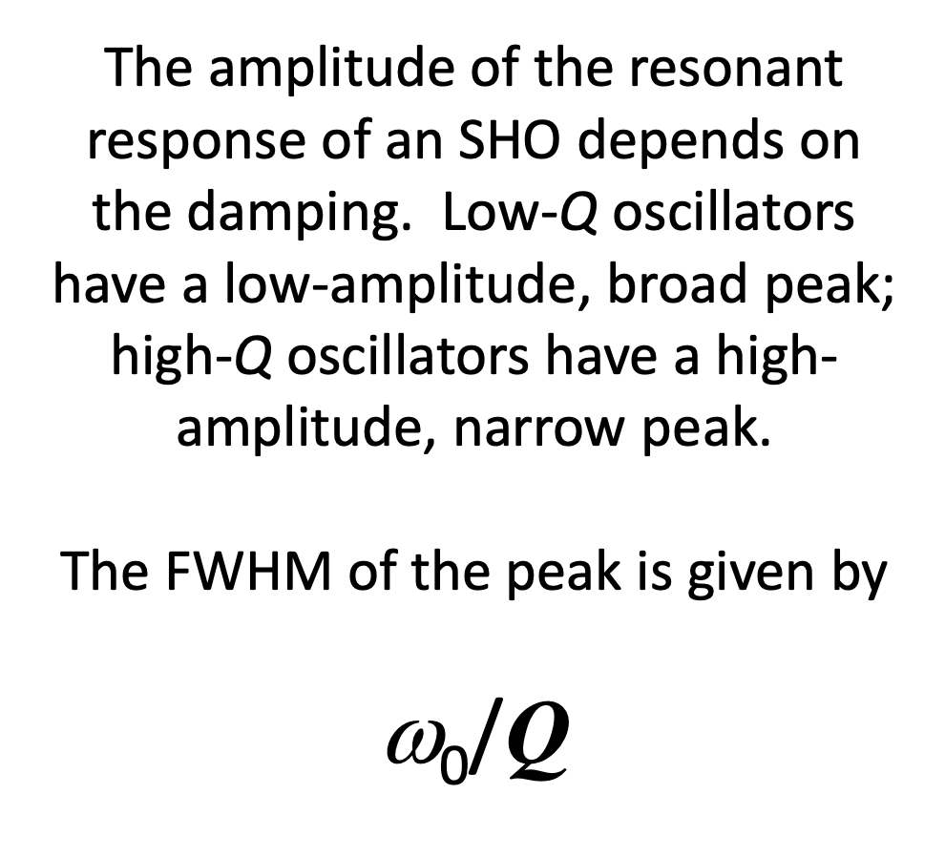
The width of the resonance curve Δω at resonant frequency ω₀ in a circuit with quality factor Q is given by
(a) ω₀ (b) Qω₀ (c) ω₀/Q ?
How can you explain this result?

Slide 6
Two capacitors C₁ and C₂ are connected in series. What is the overall capacitance? What is the capacitance if instead they are connected in parallel?

