Slide 1
Oscillations Core GReP workshop 2
Define the Q-factor of an oscillator and explain how this relates to variations in current in an oscillating LC circuit.
How would you increase the Q-value of a circuit without changing its resonant frequency?
How does the rate of power dissipation change as the Q-value is increased for (a) a damped SHO, (b) a forced, damped SHO, (c) your LCR circuit?
The width of the resonance curve Δω at resonant frequency ω₀ in a circuit with quality factor Q is given by
(a) ω₀ (b) Qω₀ (c) ω₀/Q ?
How can you explain this result?
Two capacitors C₁ and C₂ are connected in series. What is the overall capacitance? What is the capacitance if instead they are connected in parallel?

Slide 2
Define the Q-factor of an oscillator and explain how this relates to variations in current in an oscillating LC circuit.

Slide 3
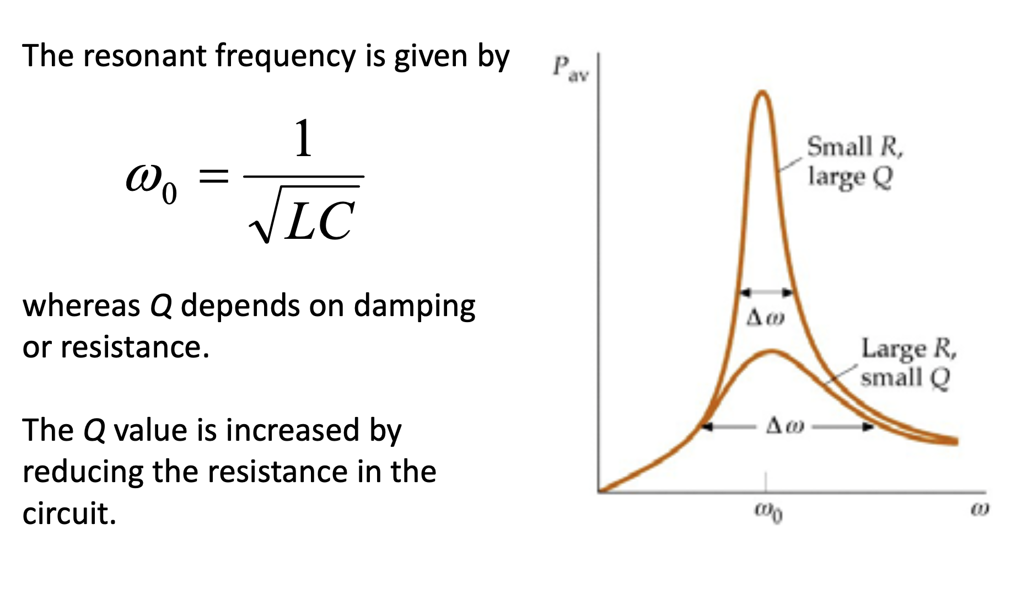
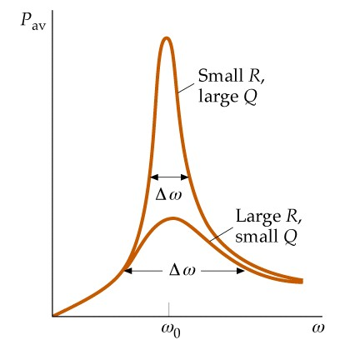
How would you increase the Q-value of a circuit without changing its resonant frequency?

Slide 4
How does the rate of power dissipation change as the Q-value is increased for (a) a damped SHO, (b) a forced, damped SHO, (c) your LCR circuit?
As before, if Q is increased, damping and hence energy dissipation must decrease.
$P∝\frac{1}{Q}$ at a given amplitude
In a forced, damped SHO, energy dissipation depends on driving force and velocity. Since velocity is maximized at resonance, energy dissipated increases with Q.
$P∝Q$ since $P=Fv$
In LCR circuit, power dissipation depends on current flowing in resistor. Again, this is maximised at resonance and
$P∝Q$ and $P={VI=I}^{2}R$

Slide 5
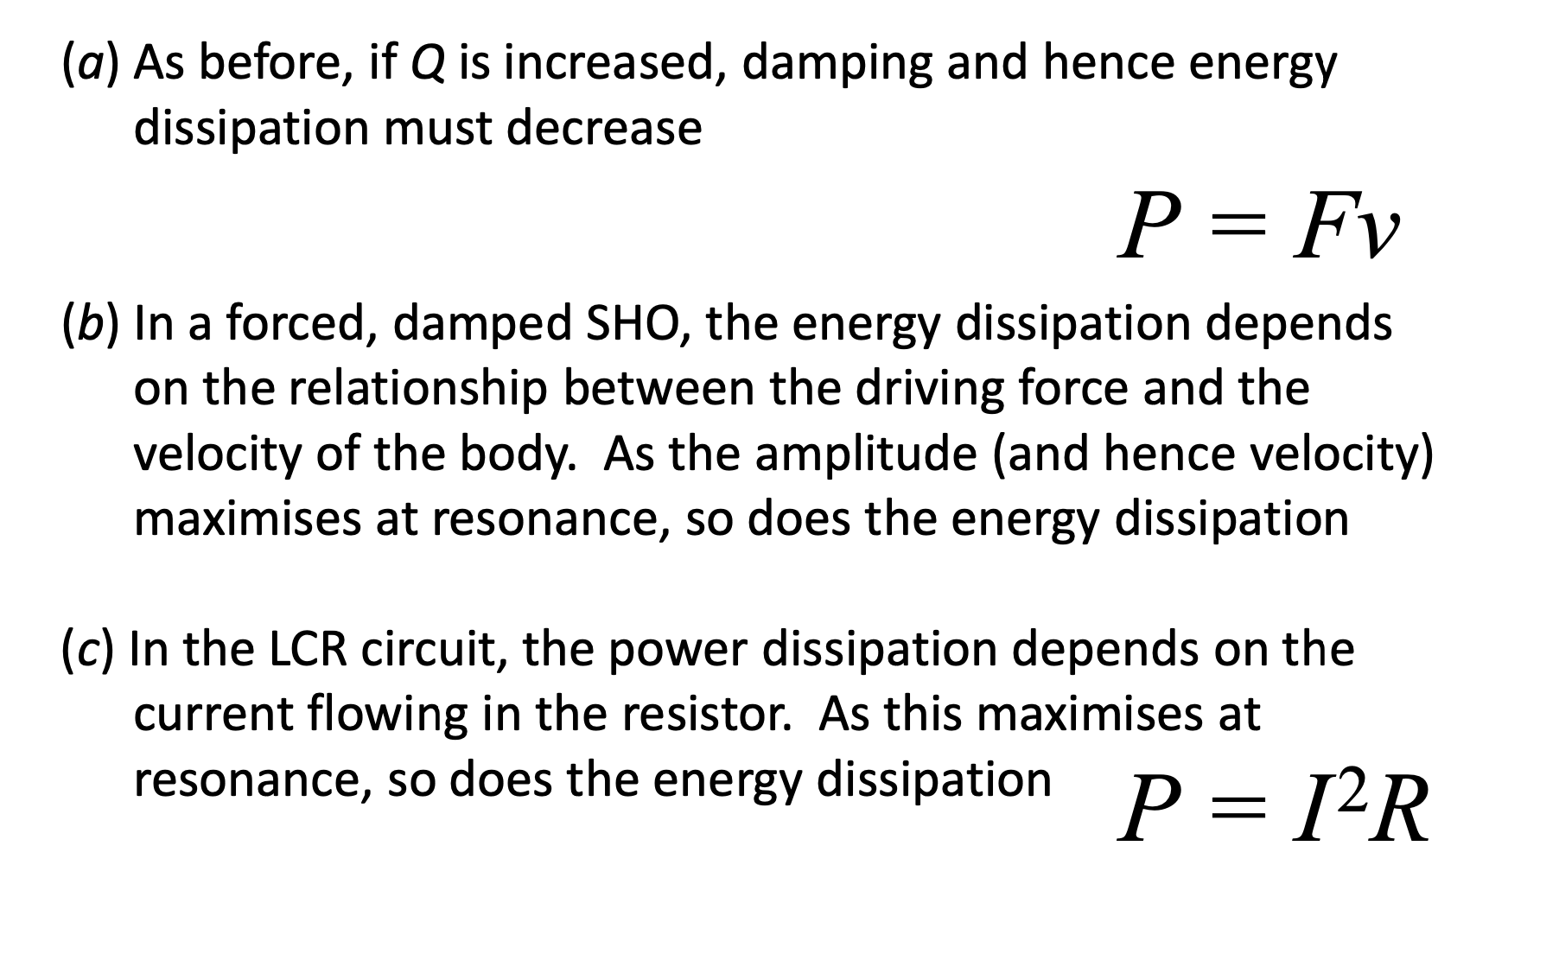
How does the rate of power dissipation change as the Q-value is increased for (a) a damped SHO, (b) a forced, damped SHO, (c) your LCR circuit?

Slide 6
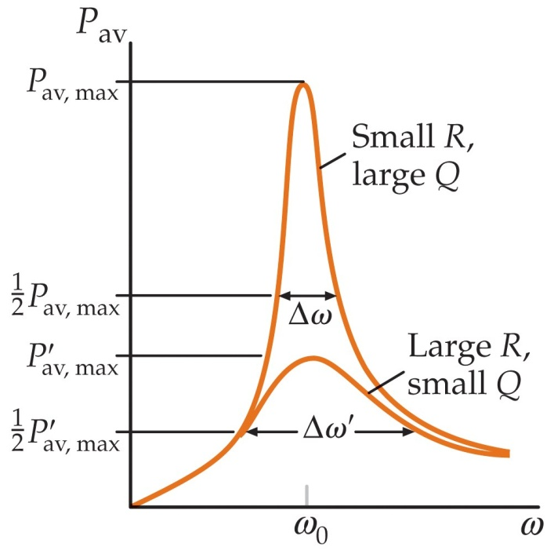
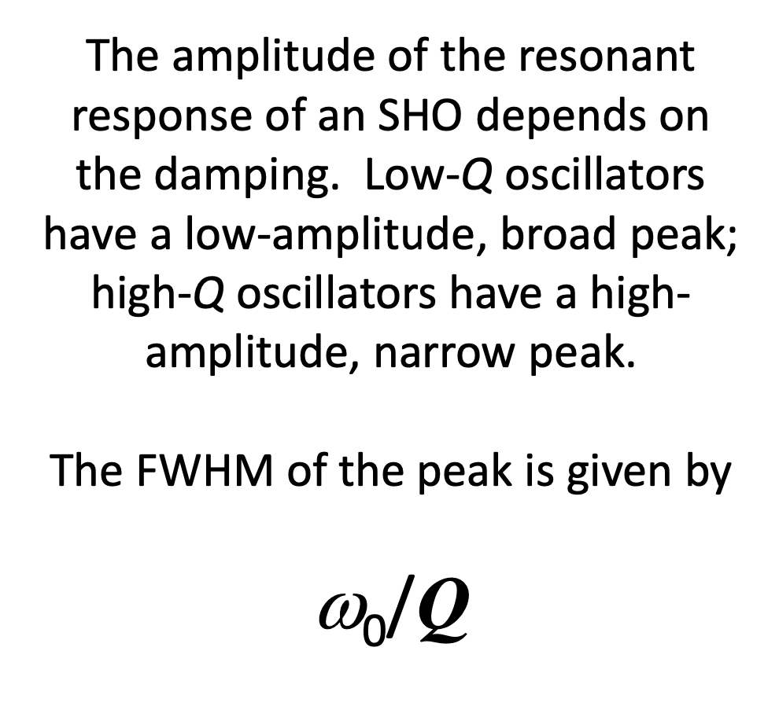
The width of the resonance curve Δω at resonant frequency ω₀ in a circuit with quality factor Q is given by
(a) ω₀ (b) Qω₀ (c) ω₀/Q ?
How can you explain this result?
$$Q=\frac{ω_{0}}{Δω} ⟹ Δω=\frac{ω_{0}}{Q}$$

Slide 7
Two capacitors C₁ and C₂ are connected in series. What is the overall capacitance? What is the capacitance if instead they are connected in parallel?

