Slide 1
Oscillations Core GReP workshop 1
1. Derive an approximate formula for the inductance of a coil in terms of its physical dimensions, stating your assumptions. How does the inductance depend on the area of the coil and the number of turns? Explain this dependence in physical terms.
2. Derive a formula for the capacitance of a parallel plate capacitor in terms of its physical dimensions. How does the capacitance depend on (a) the dielectric (b) the plate area (c) the plate separation? Explain this dependence in physical terms.
3. The differential equation for a driven LCR circuit is
By analogy with a forced oscillation of a mass on a spring, what are the equivalents of mass, damping, and resonant frequency? Explain the analogy in physical terms.
4. What is the natural frequency ω₀ of an LCR circuit? How do you expect the amplitude of variations in charge (Q) to change as the driving frequency is varied slowly from ω < ω ₀ to ω > ω ₀?
$$L\frac{d^{2}Q}{dt^{2}}+R\frac{dQ}{dt}+\frac{1}{C}Q=V_{0}\cos{ωt}$$

Slide 2
Derive an approximate formula for the inductance of a coil in terms of its physical dimensions, stating your assumptions. How does the inductance depend on the area of the coil and the number of turns? Explain this dependence in physical terms.
Inductance defined as the magnetic flux produced by the coil per unit current passing through the coil:

Slide 3
I
B
A
r
N

Slide 4
N
I
l

Slide 6
Inductance increases with a greater N and r as this increases
the flux contained within the coils
Inductance decreases with greater l as this reduces the number
of turns in unit length, decreasing the flux contained within
the coils

Slide 7
2. Derive a formula for the capacitance of a parallel plate capacitor in terms of its physical dimensions. How does the capacitance depend on (a) the dielectric (b) the plate area (c) the plate separation? Explain this dependence in physical terms.
d
V
A

Slide 8
2. Derive a formula for the capacitance of a parallel plate capacitor in terms of its physical dimensions. How does the capacitance depend on (a) the dielectric (b) the plate area (c) the plate separation? Explain this dependence in physical terms.
+Q
+ + + + + + + +
d
E
V
A
- - - - - - - -
-Q

Slide 9
a
+Q
+ + + + + + + +
E
What is the electric field of a single charged plate?

Slide 10
a
-Q
- - - - - - - -
E
What is the electric field of a single charged plate?

Slide 11
E = 0
+Q
+ + + + + + + +
-Q
- - - - - - -
E = 0

Slide 12
Electric field between
charged plates
Definition of capacitance

Slide 13
Capacitance increases with a greater A as the charge on the
plates is spread out, and more charge can be accumulated
before leading to a high electric field between the plates
Capacitance decreases with greater d as this leads to a greater
potential difference between the plates, and the more difficult
it is to accumulate charge on them
Capacitance increases with increasing ε as this reduces the
electric field between the plates and hence the potential difference

Slide 14
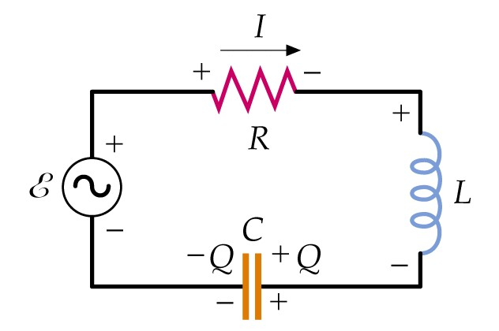
3. The differential equation for a driven LCR circuit is
By analogy with a forced oscillation of a mass on a spring, what are the equivalents of mass, damping, and resonant frequency? Explain the analogy in physical terms.
$$L\frac{d^{2}Q}{dt^{2}}+R\frac{dQ}{dt}+\frac{1}{C}Q=V_{0}\cos{ωt}$$
Deriving this expression:
Apply Kirchhoff’s loop rule:
Substitute for I:

Slide 15
Mechanical analogy, mass on a spring:
LCR circuit | Mass on spring
Q | x | charge flows back and forth, mass moves back and forth
1/C | k | capacitor wants to discharge, spring pushes mass
L | m | inductor resists change in current flow, mass has inertia
R | b | energy dissipation in resistor, frictional force on mass
 |  | natural frequency at which resonance occurs depends on square root of restoring force divided by inertia

Slide 16
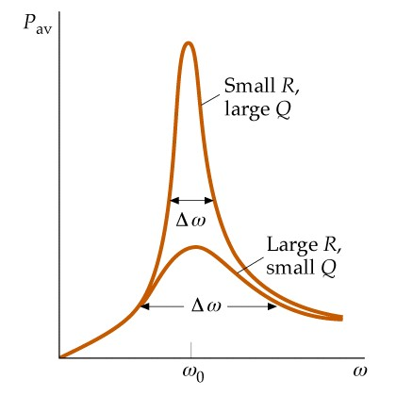
4. What is the natural frequency ω₀ of an LCR circuit? How do you expect the amplitude of variations in charge (Q) to change as the driving frequency is varied slowly from ω < ω ₀ to ω > ω ₀?
The resonant frequency is given by
The charge oscillates at the driving
frequency ω. The amplitude of
oscillation is a maximum at the
resonant frequency ω = ω₀, and
decreases at lower and higher
driving frequencies.

