Slide 1
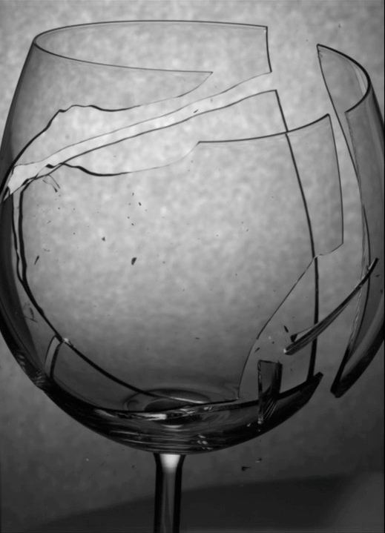

PA114 Core GReP
Resonance
in LCR circuits

Slide 2
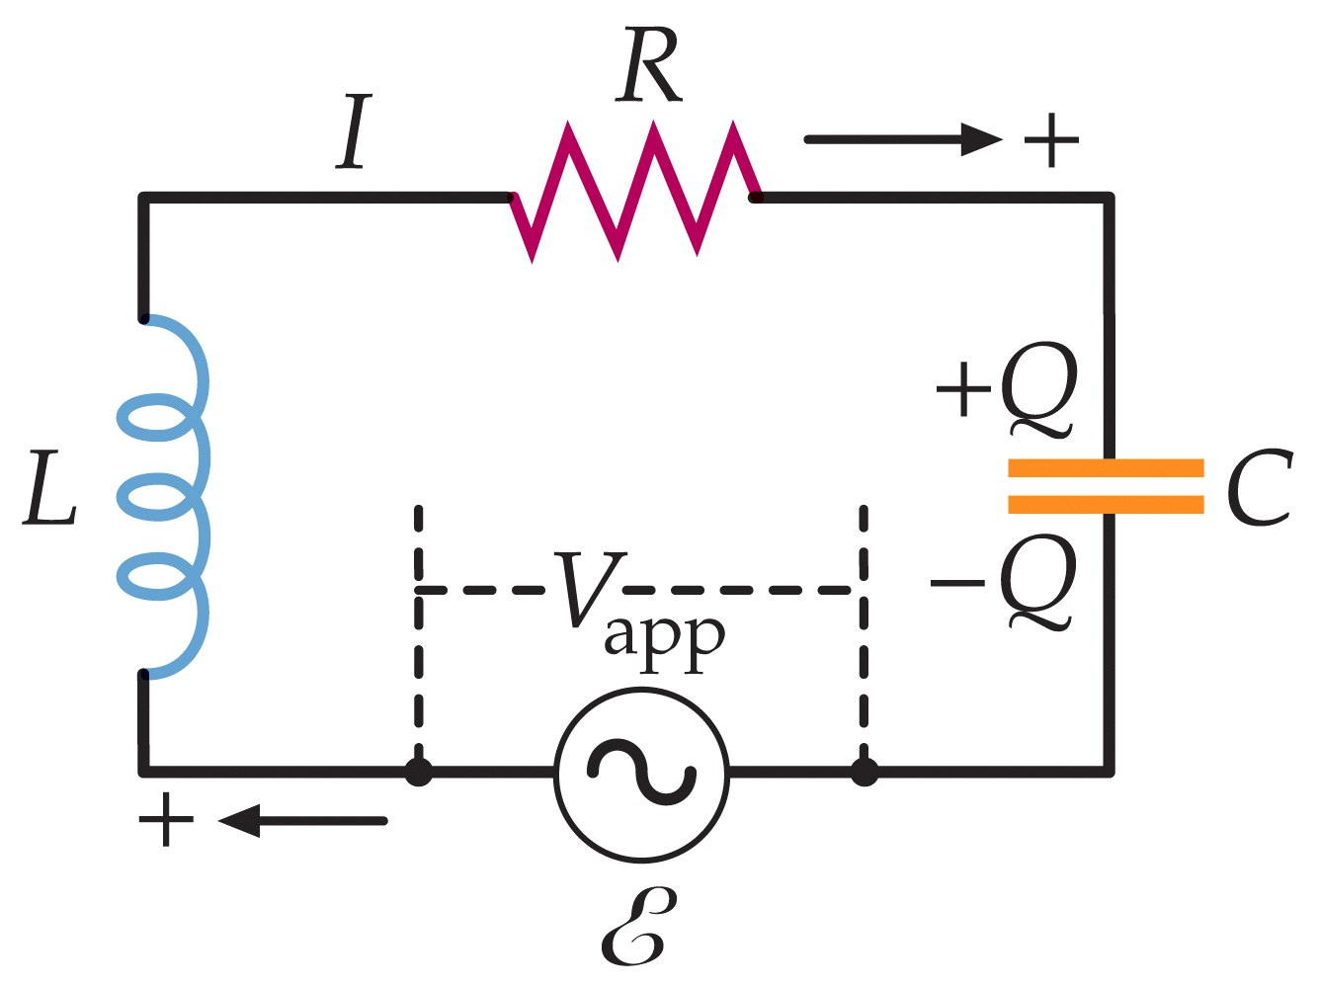
Introduction
Most oscillatory systems display resonance phenomena.
Although the detailed physics may be different in each system,
the mathematics behind resonance is common to each.
In this project you will investigate resonance in an LCR circuit,
consisting of an inductor (L), capacitor (C), and resistor (R).

Slide 3
Approach:
Build and understand the operation of an LCR circuit
Find how the behaviour of LCR circuits, and especially the resonant
frequency, depend on the values of L, C, and R.
Determine how the resonant frequency can be used to measure C.
Use this knowledge to measure the dielectric constant of an unknown substance (sugar).
Equipment provided:
Signal generator and oscilloscope (on the computer)
Coils (Inductors); fixed and variable capacitors; resistors
Parallel plate capacitor and sugar

Slide 4
Relation to Core Courses
PA1140
SHM
Resonance
PA1720
LCR circuits
Dissipation
PA1130
Inductance
Capacitance, dielectric constant

Slide 5
Schedule
Week 1
Thursday 28/02/19 Student Block 1 Experiment 1. LCR circuit
Friday 01/03/19 Student Block 2 Experiment 1. LCR circuit.
Monday 04/03/19 Student Block 1 Workshop questions 1.
Tuesday 05/03/19 Student Block 2 Workshop questions 1.
Week 2
Thursday 07/03/19 Student Block 1 Experiment 2. Variable capacitor
Friday 08/03/19 Student Block 2 Experiment 2. Variable capacitor
Monday 11/03/19 Student Block 1 Workshop questions 2
Tuesday 12/03/19 Student Block 2 Workshop questions 2.
Week 3
Thursday 14/03/19 Student Block 1 Experiment 3. κ for sugar
Friday 15/03/19 Student Block 2 Experiment 3. κ for sugar
Monday 18/03/19 Student Block 1 Experiment 4. repeat, catch-up
Tuesday 19/03/19 Student Block 2 Experiment 4. repeat, catch-up

Slide 6
Please note that the student year is split into TWO BLOCKS.
BLOCK 1: consists of student groups
A1, A3, B1, B3, C1, C3, D1, D3, E1, E3, F1, F3,
BLOCK 2: consists of student groups
A2, A4, B2, B4, C2, C4, D2, D4, E2, E4, F2, F4,

Slide 7
Experiment 1
Use the given components to build an LCR circuit; find the resonance frequency using the signal generator to power the circuit at a range of frequencies and the oscilloscope to determine its response
Driving circuit Resonant circuit Measure response
Aside:
What is the purpose of the second induction coil?
A signal generator is designed to maintain a voltage in a circuit to which it is physically connected at the frequency chosen, whether or not this is the resonant frequency.
This defeats the object of the exercise to find the frequency for which there is a maximum voltage response!
The signal generator is connected via the coil to negate this effect.

Slide 8
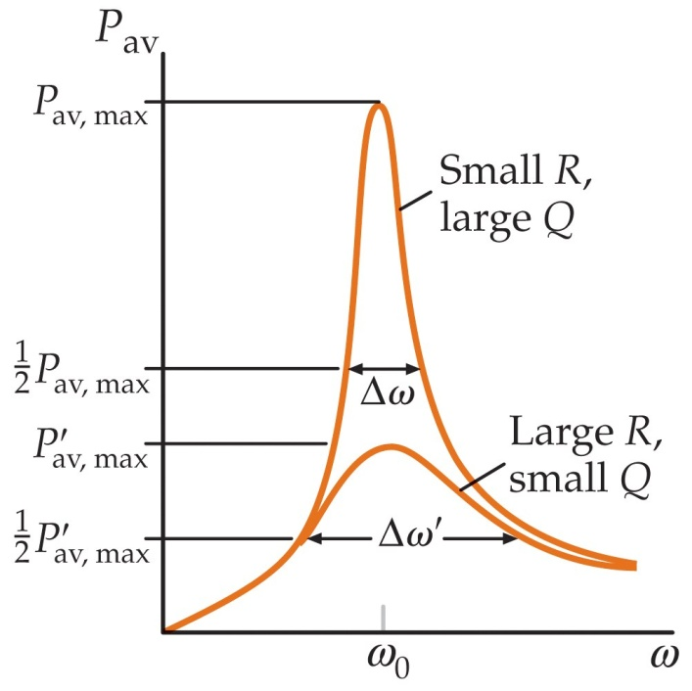
Course of action
Measure L and compare with a calculated value
Find a formula for the resonant frequency of the
circuit and calculate it
Find a formula for the resonance width
– quality factor Q
Pair 1: Sweep through the frequency range, record and plot the output
Pair 2: Sweep through the frequency again with a different R
Compare with theory.

Slide 9
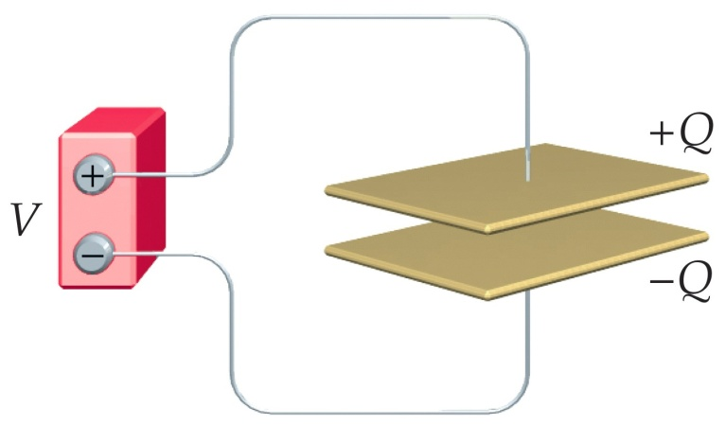
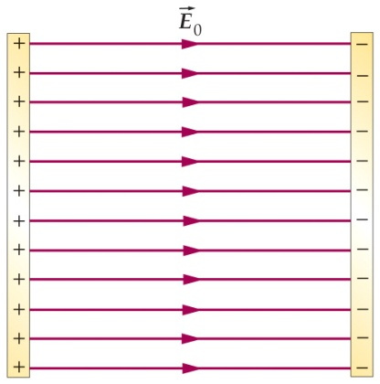
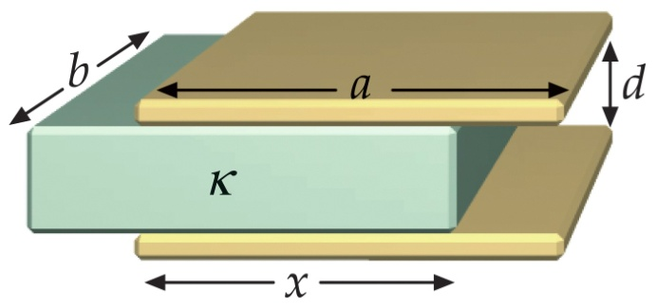
Experiment 2
Measure the dielectric constant of perspex and compare with known value
Course of action
Formula for capacitance of a parallel plate
capacitor with and without dielectric
How do you adjust the capacitance?
How do you calculate the capacitance?
What effect does this have on the
resonance frequency?
Tipler Ch. 24

Slide 10
Experiment 3
Measure the dielectric constant of sugar
Course of action
Use the knowledge gained in previous experiments to determine the dielectric constant of an “unknown” substance
Experiment 4
Repeat measurements, catch up, finish off.

Slide 11
Core GReP rules – a reminder
The problems should be worked through in order.
Keep a project plan and copious notes in your laboratory notebooks.
Each member of the group must engage with all aspects of each problem. This should be apparent from your notebooks.
It is more important to complete the tasks effectively and reflectively than to rush to the end. You will be assessed on your engagement with the problem.
You must attend laboratory sessions but you may work outside scheduled classes if you wish.
If you do not have time to obtain data for all the experiments your report should indicate how you would have collected data and how you would have analysed it.
The report is a group responsibility; it should be clear that it has been “signed off” by the group as a whole.

Slide 12
Submission of reports
Files are submitted to Blackboard under the module PA1900: Experiment Physics 1 2018-10 Y > Assessment and Feedback > PA1900 GReP Report 2018-19
Instructions are in your documentation.
Files MUST be named with the following convention
114GReP_Group Letter_UserName_Report.filetype
e.g. 114GReP_Group A1_zyx5_Report.pdf
and KEEP A COPY
Submission Deadline for Group Reports: 2pm
Thursday 28 March

