Slide 1
PA114 – Waves and Quanta
Unit 3 – Workshop - Answers

Slide 2
Q.1

Slide 3
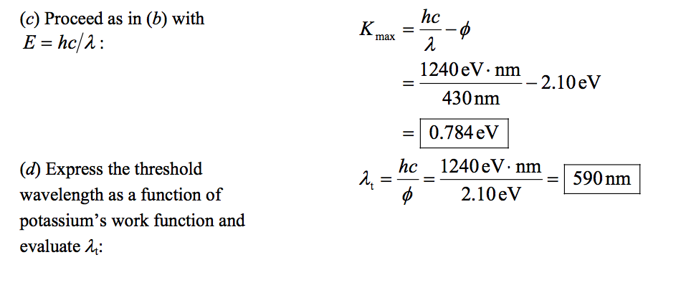

Slide 4
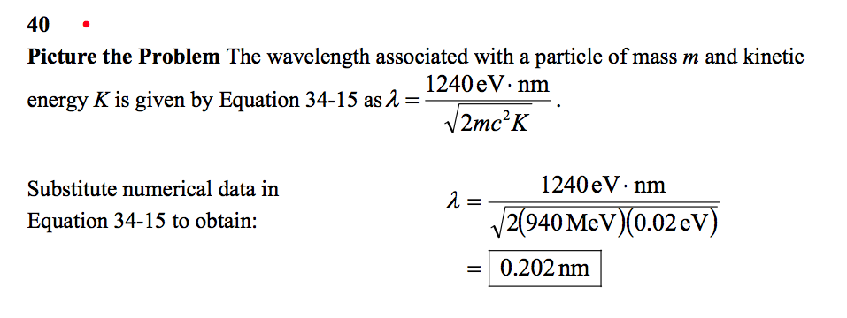
Q.2

Slide 5
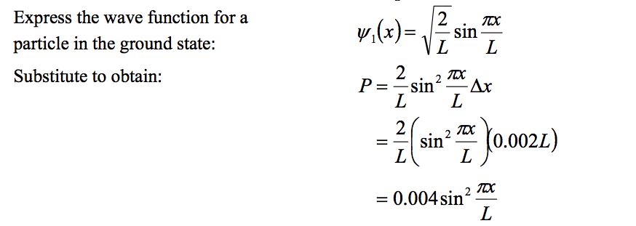
Q.3

Slide 6
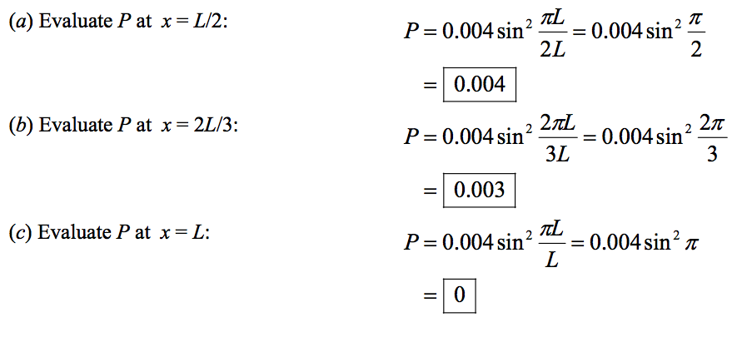

Slide 7
Q.4
(a)
(b)

Slide 8
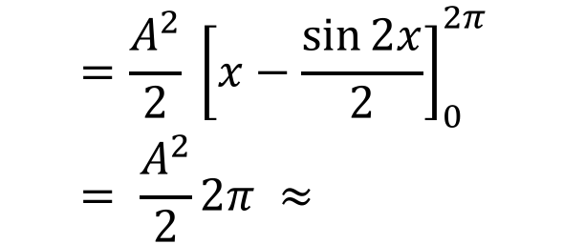
(c)
$$<x> =\int_{0}^{2π}{x \frac{A^{2}\sin^{2}{x}}{x} dx= \frac{A^{2}}{2}}\int_{0}^{2π}{1−\cos{2x} dx}$$
$$=\frac{A^{2}}{2} {\left[x−\frac{\sin{2x}}{2}\right]}_{0}^{2π} = \frac{A^{2}}{2}2π ≈$$
2.01

Slide 9
Concept Question.
A particle in a 1-D box can be accurately modelled as if it was a ball bouncing backwards and forwards between the two walls.
FALSE (nodes of wave-function are places particle cannot be)
Interference of light occurs because photons interfere with themselves rather than each other.
TRUE
A very well localised particle must have a very uncertain wavelength.
TRUE (from HUP since wavelength depends on momentum)

