Slide 1
PA1140 – Waves and Quanta
Unit 3 – Workshop - Solutions

Slide 2

Q 3.1
Energy of photon $E=\frac{hc}{λ}≈\frac{4.1×{10}^{−15}×3.0×{10}^{8}}{300×{10}^{−9}}≈\frac{1240}{300}=4.13 eV$
Q 3.2
Work function $φ=E−K≈4.13−2.03=2.1 eV$
Q 3.3
Threshold wavelength $λ=\frac{hc}{φ}≈\frac{1240}{2.1}=590 nm$
Q 3.4
de Broglie wavelength $λ=\frac{h}{p}=\frac{hc}{\sqrt{2mc^{2}K}}≈\frac{1240}{\begin{aligned}\sqrt{2×9.4×{10}^{8}×2×{10}^{−2}} \\ \end{aligned}}$
$=0.202 nm$

Slide 3
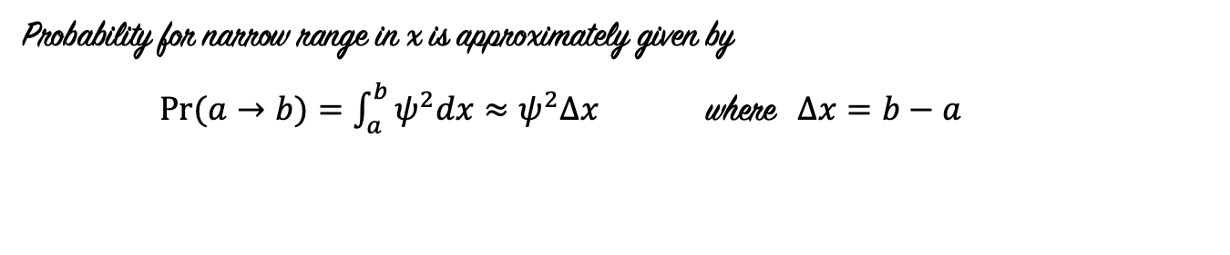
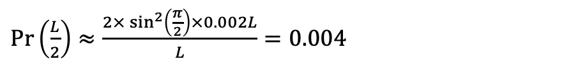
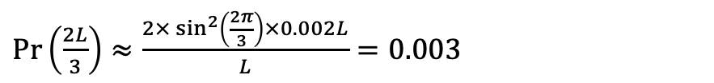


Q 3.5
Probability for narrow range in x is approximately given by
$Pr⁡(a→b)=\int_{a}^{b}{ψ^{2}dx}≈ψ^{2}Δx$ where $Δx=b−a$
For ground state of particle in box
$\operatorname{Pr}{(x)}≈\frac{2}{L}\sin^{2}{\frac{πx}{L}}.Δx$
$\operatorname{Pr}\left(\frac{L}{2}\right)≈\frac{2×\sin^{2}\left(\frac{π}{2}\right)×0.002L}{L}=0.004$
(a)
$\operatorname{Pr}\left(L\right)≈\frac{2×\sin^{2}\left(π\right)×0.002L}{L}=0$
(b)
$\operatorname{Pr}\left(\frac{2L}{3}\right)≈\frac{2×\sin^{2}\left(\frac{2π}{3}\right)×0.002L}{L}=0.003$
(c)

Slide 4
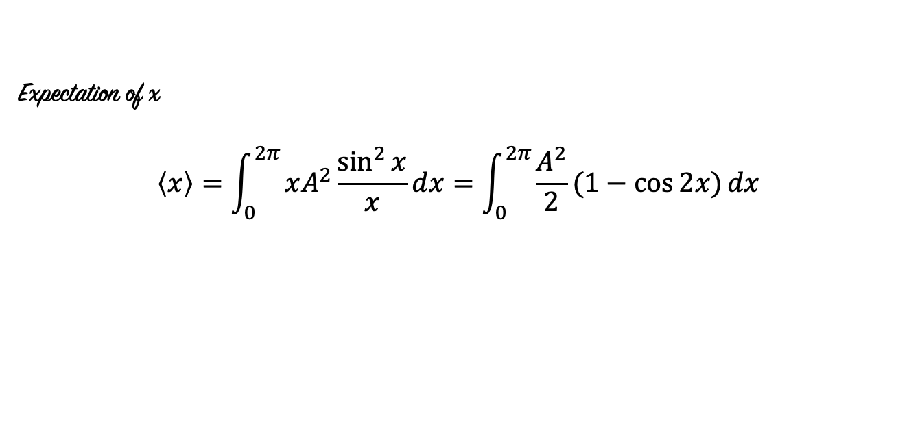
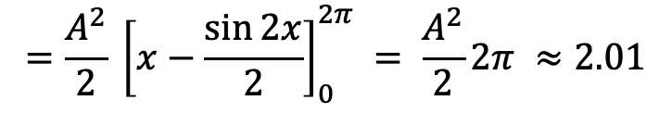
Q 3.6
(a)
(b)
(c)
Expectation of x
$$\left\langle x\right\rangle =\int_{0}^{2π}{xA^{2}\frac{\sin^{2}{x}}{x}dx=\int_{0}^{2π}{\frac{A^{2}}{2}(1−\cos{2x)}dx}}$$
$$=\frac{A^{2}}{2} {\left[x−\frac{\sin{2x}}{2}\right]}_{0}^{2π} = \frac{A^{2}}{2}2π ≈2.01$$

