Slide 1
PA1140 – Waves and Quanta
Unit 4 – Workshop - Solutions

Slide 2

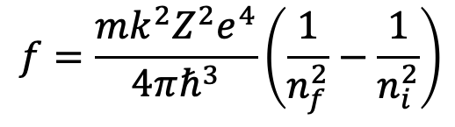

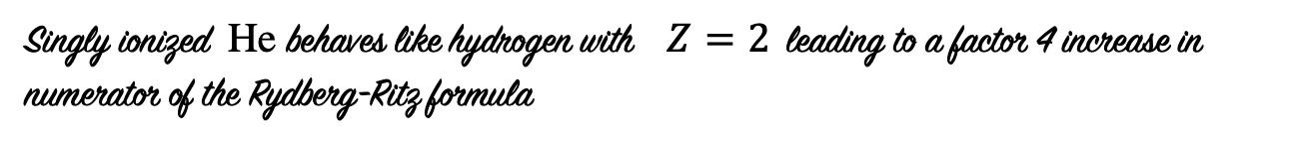
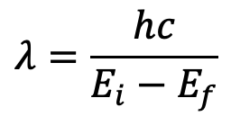
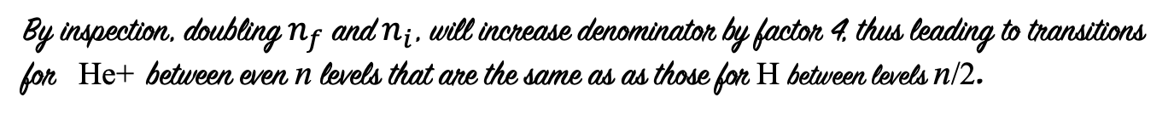
Q 4.1
(a)
Singly ionized He behaves like hydrogen with $Z=2$ $\text{leading} \text{to} \text{a} \text{factor}\text{ 4 }\text{increase} \text{in} \text{numerator} \text{of} \text{the} \text{Rydberg}\text{−}\text{Ritz} \text{formula}$
$$f=\frac{mk^{2}Z^{2}e^{4}}{4πℏ^{3}}\left(\frac{1}{n_{f}^{2}}−\frac{1}{n_{i}^{2}}\right)$$
By inspection, doubling $n_{f}$ and $n_{i}$, will increase denominator by factor 4, thus leading to transitions for He+ between even n levels that are the same as as those for H between levels n/2.
(b)
Writing the formula for wavelength
$$λ=\frac{hc}{E_{i}−E_{f}}$$
where $E_{n}={−Z}^{2}\frac{E_{0}}{n^{2}}$ , $E_{0}=13.6$eV , $hc=1240 eV nm$
$=\frac{1240}{−1.51+3.40}=656 nm$
where $E_{6}=−1.51 eV$ , $E_{4}=−3.40$eV
Which is the same as the n = 3 to 2 transition of H (Balmer –alpha)

Slide 3
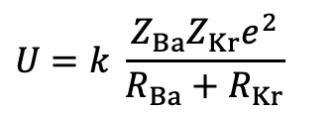

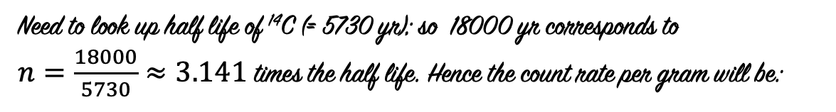


Q 4.2
Assuming the daughter nuclei are initially touching, the electrostatic potential energy is given by
$$U=k \frac{Z_{Ba}Z_{Kr}e^{2}}{R_{Ba}+R_{Kr}}$$
Where $R_{Ba}=R_{0}A_{Ba}^{1/3} , R_{Kr}=R_{0}A_{Kr}^{1/3}$
$= \frac{8.99×{10}^{9}}{1.2×{10}^{−15}}×\frac{56×36×{(1.6×{10}^{−19})}^{2}}{{(144}^{1/3}+{89}^{1/3})} =3.98×{10}^{−11 }J =249$ MeV
Q 4.3
Need to look up half life of ¹⁴C (= 5730 yr); so 18000 yr corresponds to
$n=\frac{18000}{5730}≈3.141$ times the half life. Hence the count rate per gram will be:
$R= {\left(\frac{1}{2}\right)}^{n}R_{0}=1.7$ cts min⁻¹ g⁻¹
Thus, to achieve 5 cts/min requires
$$M=\frac{5}{1.7}≈2.94 g$$

Slide 4

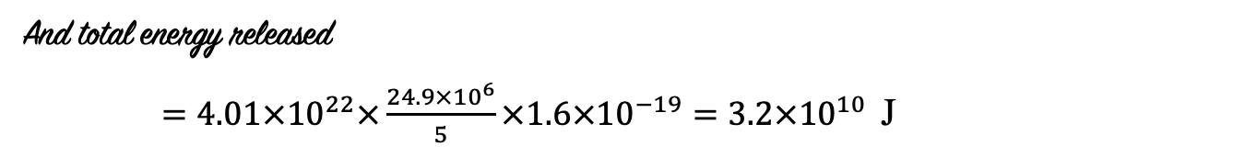


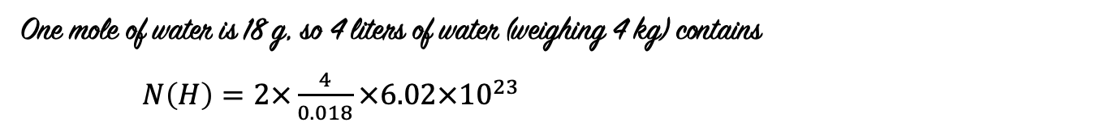
Q 4.4
Consider five ²H which proceed by the two given channels, thus releasing
$E=3.27+4.03+17.6=24.9$ MeV
One mole of water is 18 g, so 4 liters of water (weighing 4 kg) contains
$N\left(H\right)=2×\frac{4}{0.018}×6.02×{10}^{23}$
since $N_{A}=6.02×{10}^{23}$atoms/mole
Hence, number of deuterons
$N\left(D\right)=1.5×{10}^{−4}N(H)≈4.01×{10}^{22}$
And total energy released
$=4.01×{10}^{22}×\frac{24.9×{10}^{6}}{5}×1.6×{10}^{−19}=3.2×{10}^{10}$ J
Notes:
About 8 tons of TNT

