Slide 1
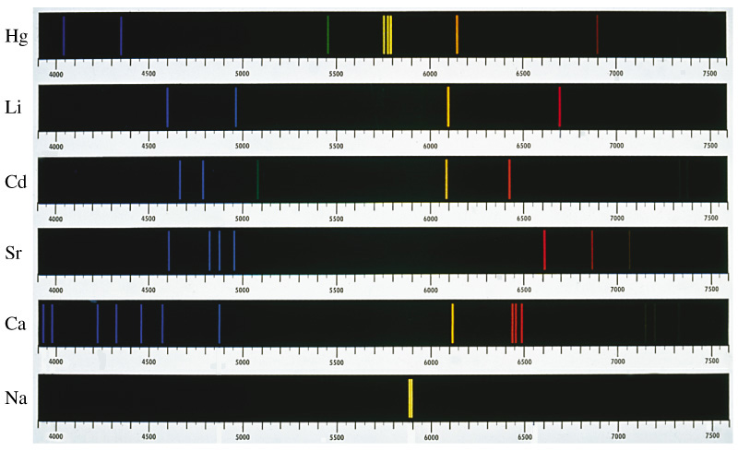
PA1140: WAVES AND QUANTA Unit 3: Introduction to quantum mechanics
Lecturer: Prof Nial Tanvir (G20)
nrt3@le.ac.uk

Slide 3
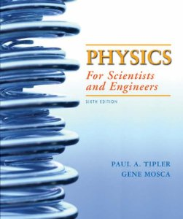
Reading
Chapter 34 in Tipler 6th edition

Slide 4
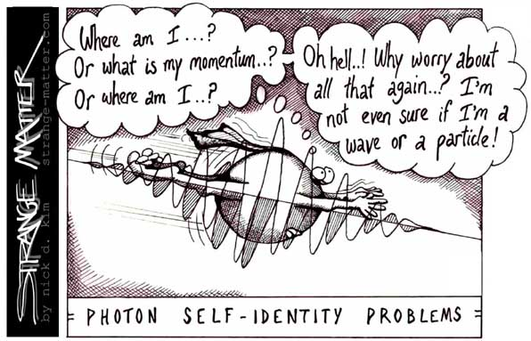
Lecture 1: the particle nature of light
Reality is fundamentally stranger than was imagined in classical physics. Energy comes in discrete packages and particles obey probabilistic rules and hence behave as if they were waves. In a deep sense, properties of a particle, such as its position and velocity, do not seem to truly exist until they are measured.

Slide 5
Lecture 1: the particle nature of light
Despite the impressive evidence from optics that light behaves as a wave, the results of other experiments show that light also has a particle nature.

Slide 6
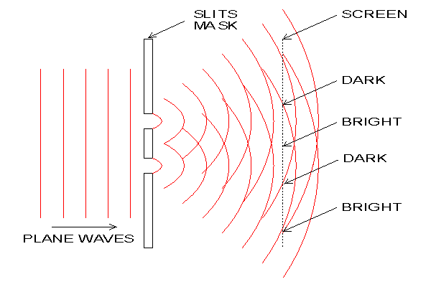
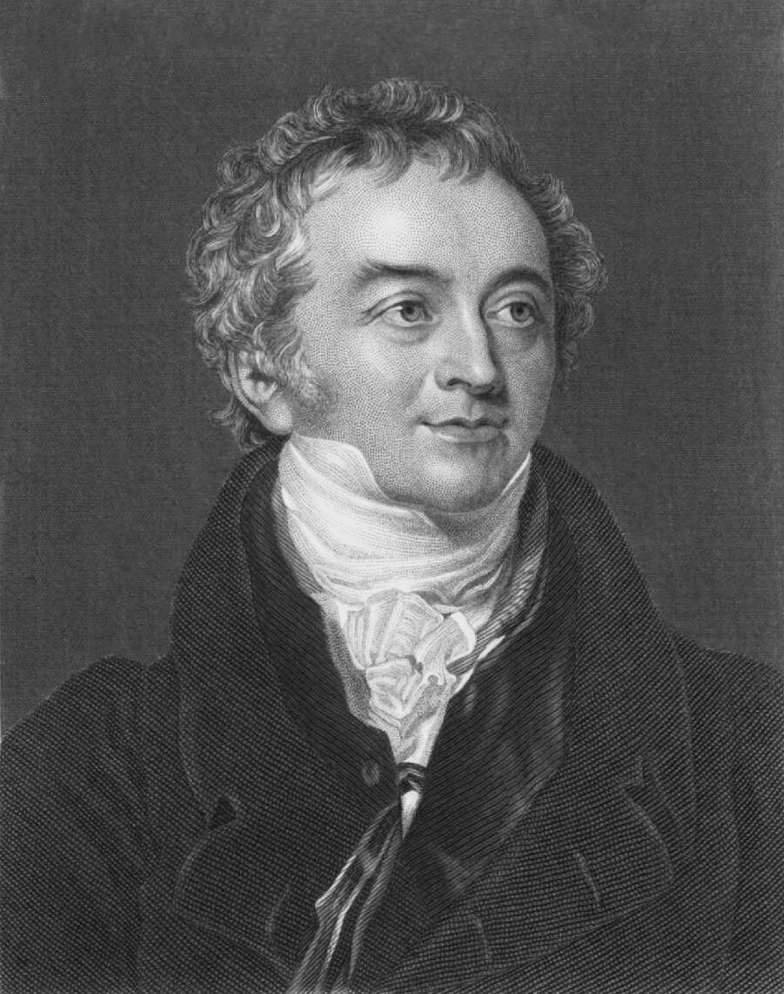
Evidence that light is a wave: diffraction and interference
We are familiar with the idea that light is a wave. The evidence is, for example, the constructive and destructive interference seen in Young’s slits experiment. There is no way of understanding this behaviour in terms of classical particles.
Difference in path length = nλ ⇒ Constructive interference

Slide 7
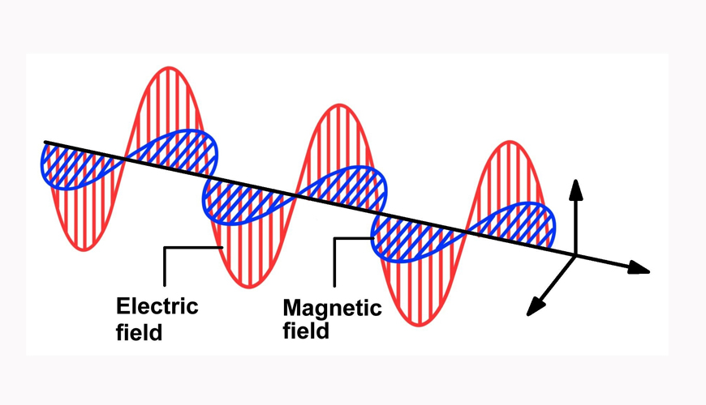
Light as electromagnetic waves
Furthermore, Maxwell showed that light consists of electromagnetic waves: oscillations in the electric and magnetic fields. Thus, by the late 19th century the wave theory of light was considered very well established.
Notes:
Crucial point is that processes like inductance have a time delay

Slide 8
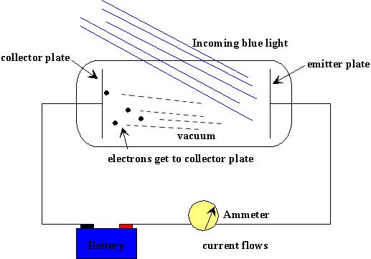
Evidence that light is formed of particles: the photoelectric effect
Newton had earlier developed an elaborate and successful theory of light as particles (he called them corpuscles). Although this theory became discredited, in the early 20th century it gradually became clear that light sometimes does behave in ways which can only be understood in terms of localised particles. The most famous of these phenomena is the photoelectric effect.
Max electron KE
Max electron KE
Light intensity
Light frequency
Number of electrons
Number of electrons
Light intensity
Light frequency
Notes:
Could describe the picture of waves rippling in on Brighton beach, and all the pebbles stay fixed, except every now and then, one shoots up randomly with escape velocity. You know the energy is there, but how does it all get focused on one pebble?

Slide 9
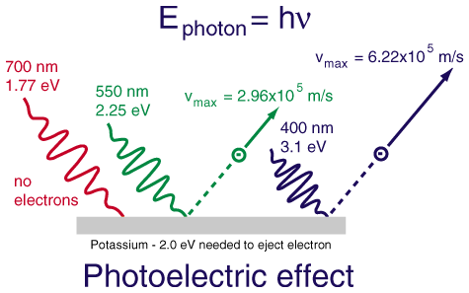
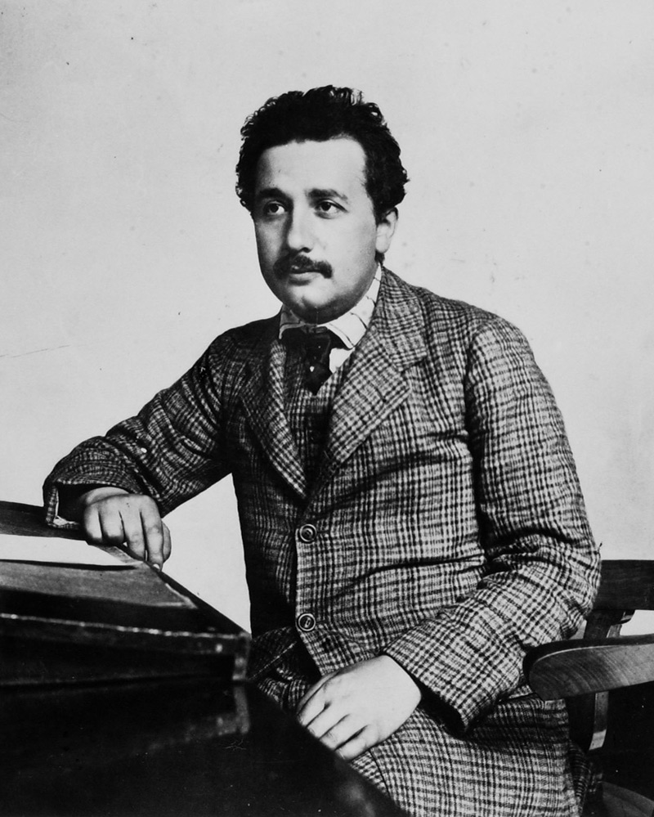
Evidence that light is formed of particles: the photoelectric effect
Annus Mirabilis
This behaviour makes no sense in terms of waves, but, as Albert Einstein pointed out in 1905, is perfectly consistent with a particle picture for the light, in which each light particle (photon) has an energy proportional to its frequency.
E_{photon}=hf
1 eV=1.6x10⁻¹⁹J
KE_{max}=hf - φ
; where φ is the so-called work function, which is the minimum energy required to remove an electron, and varies from metal to metal.
N.B. h = 6.63×10⁻³⁴ J s is the Planck constant.

Slide 10
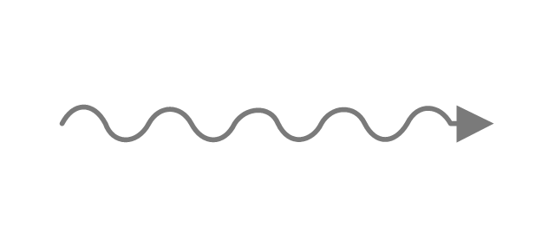
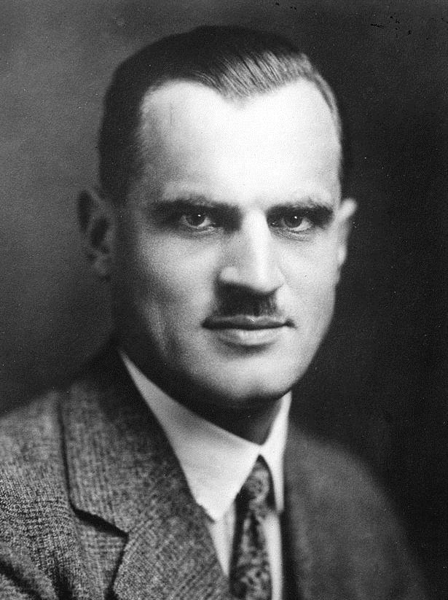
Evidence that light is formed of particles: Compton scattering
Another phenomenon which illustrates the “quantised” particle nature of light is Compton scattering (1923). When photons collide with particles such as electrons the collisions obey mechanics of “billiard balls” rather than the more spread out kinds of interactions we would expect of waves.
e
Notes:
Chronologically Compton was later, in 1920s, so the necessary relativistic understanding was in place.
I don’t believe they have met E^2=p^2 c^2 + m_0^2 c^4 – need to introduce that carefully. (or sidestep)

Slide 11
Evidence that light is formed of particles: Compton scattering
Another phenomenon which illustrates the “quantised” particle nature of light is Compton scattering (1923). When photons collide with particles such as electrons the collisions obey mechanics of “billiard balls” rather than the more spread out kinds of interactions we would expect of waves.
$$θ$$
e
$$φ$$
Assume photons carry momentum
e
Momentum before (x direction):
Momentum after (resolving in x and y):
$$p_{2}\cos{θ+}p_{e}\cos{φ }$$
$$p_{1}$$
$$p_{2}\sin{θ=p_{e}\sin{φ}}$$
Notes:
Chronologically Compton was later, in 1920s, so the necessary relativistic understanding was in place.
NB. MOMENTUM OF PHOTON APPEARS OUT OF BLUE HERE – ESPECIALLY NEED TO THINK HOW TO INTRODUCE E=pc HERE AND TO RELATE THAT TO p=h/lambda.

Slide 12
Evidence that light is formed of particles: Compton scattering
So by conservation of momentum, we conclude (square both momentum equations and combine):
$$p_{1}^{2}+p_{2}^{2}\cos^{2}{θ}−2p_{1}p_{2}\cos{θ}=p_{e}^{2}\cos^{2}{φ}$$
$$p_{2}^{2}\sin^{2}{θ}=p_{e}^{2}\sin^{2}{φ}$$
Remembering
$$\sin^{2}{θ+\cos^{2}{θ}}=1$$
$${⟹p}_{1}^{2}+p_{2}^{2}−2p_{1}p_{2}\cos{θ}=p_{e}^{2}$$
For light:
$$E=pc$$
Energy before:
Energy after:
$$p_{2}c+\frac{p_{e}^{2}}{2m}$$
$$p_{1}c$$
Conservation of energy gives:
$${p_{e}^{2}=2m(p_{1}c −p}_{2}c)$$
Notes:
Lambda=h/p comes from E=hf and c=lambda x f

Slide 13
Evidence that light is formed of particles: Compton scattering
Combining:
$$p_{1}^{2}+p_{2}^{2}−2p_{1}p_{2}\cos{θ}{=2mc(p_{1} −p}_{2})$$
Providing the change in photon momentum is small, we can write:
$$p_{1}^{2}+p_{2}^{2}≈2p_{1}p_{2}$$
Since
$${(p_{1}−p_{2})}^{2}≈0$$
For light:
$$p=\frac{E}{c}=\frac{h}{λ}$$
Hence:
$$p_{1}p_{2}(1−\cos{θ}){≈mc(p_{1} −p}_{2})$$
So the change in wavelength of the photon is given by:
In fact, the full relativistic analysis gives exactly the same equation (as you’ll see next year)!
Notes:
Lambda=h/p comes from E=hf and c=lambda x f (but only if they already know E=pc!)

Slide 14
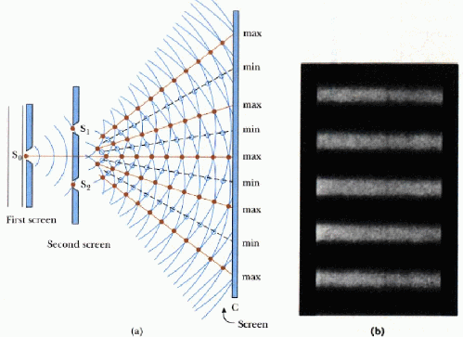
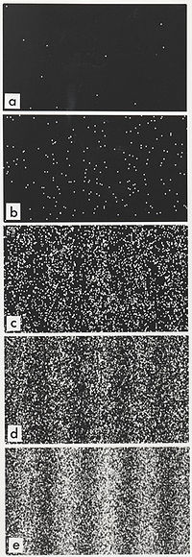
Wave-particle duality
It seems that to understand light we need a theory in which particles have wave-like behaviour in at least some circumstances. This theory is called quantum mechanics and it seems to reflect fundamental principles of nature which go beyond classical physics. To appreciate how strange wave-particle duality is, reconsider Young’s slits with a detector registering single photons.
Notes:
Take time over this. E.g. can block out one slit first etc. (unless one leaves this discussion to start of next lecture?)

Slide 15
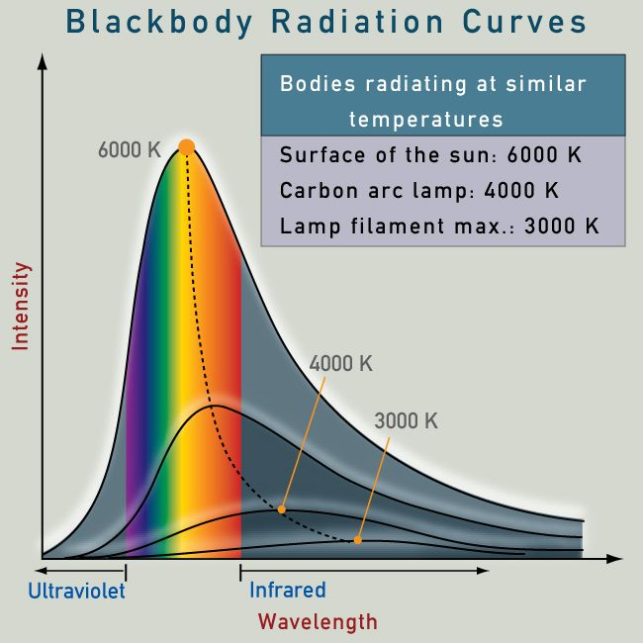
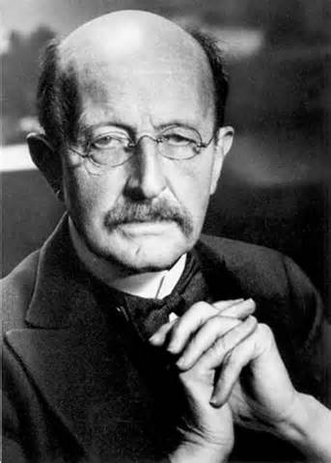
Light quanta
The first suggestion that light might come in discrete lumps came earlier, in 1900, when Max Planck noticed that the shape of a Black Body spectrum could be explained if each frequency f came in energy packets of size hf (where h = 6.63×10⁻³⁴ J s is the same Planck constant we met earlier), and obeyed statistical rules as if it were a gas of photons.
But even though this was quickly seen as a key breakthrough, even Planck was not comfortable with viewing the light quanta as completely real, and instead seems (along with most others) to have seen this approach as a kind of mathematical trick required to give the right formula.
Notes:
Might be worth commenting that although photons are “quantised” (oscillations of EM field), they still can be a continuum of frequencies – it is only in bound systems, like atoms, that we meet state quantisation (although in black body one may be quantised at longest wavelengths).

