Slide 1
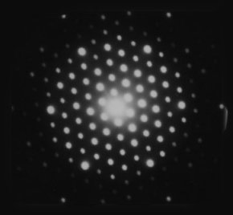
Lecture 2: matter waves and uncertainty
Wave-particle duality also extends to particles of matter. Even more remarkable, we find that the physical world, at a deep level, has an inherent uncertainty.
Notes:
By introducing probability, absolute causality is abandoned. (although might leave this point to lecture 3?)
Point out that by ~1920 there seemed to be separate, but apparently incompatible theories of light (as seen in lecture 1)

Slide 2
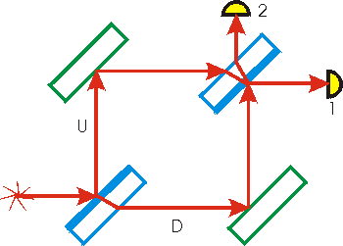
Mach-Zehnder interferometer
To emphasise again how strange wave-particle duality is, consider the simple Mach-Zehnder interferometer.
Destructive interference at detector 2
Air-to-glass reflections give $π$phase shift (glass-to-air don’t).
Constructive interference at detector 1
Does a photon choose to go way or the other; or does it somehow go both ways?
Notes:
Go through: light splits, so amplitude reduces – might think that path lengths the same mean both detectors see constructive interference, but they don’t due to the phase shifts.
Imagine sticking detectors at different points – they will show that beam splitter is decision point for photons; BUT only if there’s a detector there.

Slide 3
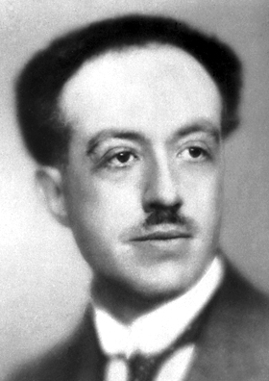
De Broglie matter waves
In 1924 Prince Louis De Broglie made the radical proposition that not only must light be considered as a wave which behaved in some circumstances like particles, but that traditional particles (electrons, protons, neutrons etc.) behave in some circumstances like waves.
The de Broglie wavelength associated with any material particle is simply given by its momentum:
λ = h/p
This explains phenomena such as electron diffraction through crystals.
The implications are profound: it means, for example, that particles (when they behave like waves) must spread out in space, and hence be in many places at once!
Notes:
Do some examples. (would this be better shifted to end of lecture 1?)
e.g. electron mass ~1e-30 kg, so if velocity ~1e6 m/s we have lambda ~1e-9m (cf. X-ray)
e.g. bowling ball ~1 kg, v~10 m/s , => lambda ~1e-34 m

Slide 4
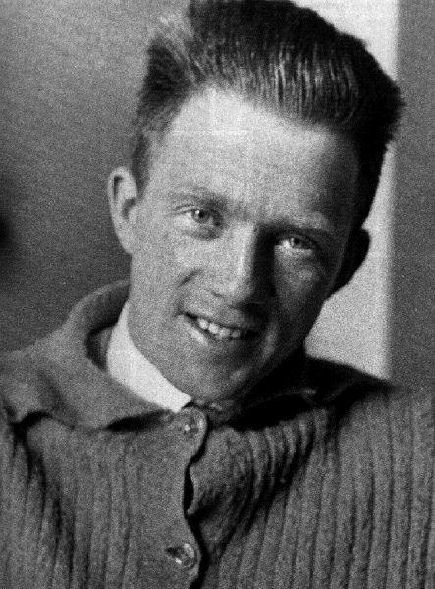
Heisenberg’s Microscope
Nudge of particle:
$$Δp=\frac{h}{λ}\sin{θ≈}\frac{h}{λ}.\frac{D}{2f}$$
Resolving power of lens:
$$\frac{∆x}{f}≈\frac{λ}{D}$$
2θ
D
f
Consider a particle viewed under a simple microscope. The particle is hit by a photon that is then focussed onto a screen by a lens. We can’t tell which path the photon has taken, which gives some uncertainty to the change in momentum that the particle will have received. We conclude:
$$∆x∆p≈ \frac{fλ}{D}.\frac{hD}{2fλ} = \frac{h}{2}$$
Notes:
The delta-p represents the “range of possible nudges, in vertical direction”
the delta-x is in vertical direction. (note that 2.theta=delta-x/f)
NB. f IS NOT FOCAL LENGTH – PERHAPS REVISIT THIS AND JUST GIVE IT A DIFFERENT SYMBOL

Slide 5
Heisenberg’s Uncertainty Principle
However the principle is even more profound than the Heisenberg microscope analysis hints at, seemingly being a fundamental limitation of nature (for greater insight, read about Bell’s Inequalities).
A remarkable consequence of wave-particle duality is that it implies certain pairs of particle properties cannot simultaneously be known to arbitrary accuracy. More rigorously, considering the uncertainty in position and momentum of a particle, Heisenberg’s Uncertainty Principle states:
$$∆x∆p>\frac{ℏ}{2}$$
Where ћ = h/2π = 1.05×10⁻³⁴ J s is the reduced Planck constant, or “hbar”.
Notes:
Explain that this reflects wave-particle duality, since a wave with certain momentum has certain wavelength.
In any event, this could be a good time to point out that we need a new theory, which for the first time in physics, is acausal? (or leave till talking about probabilities?)

Slide 6
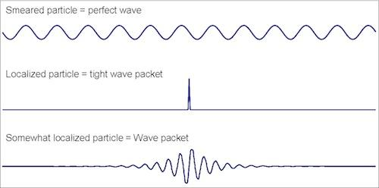
Position and momentum of a wave
Consider a wave travelling in 1-D. If it is an infinitely long sine-wave then it has a fixed wavelength (and hence fixed momentum), but its “position” is completely undefined. This is odd for a particle!
Fourier analysis tells us that we can force a wave to have a precise localisation, but only by superposing waves with a huge range of wavelengths (and hence poorly defined momentum).
Between these extremes, a wave packet may be made up of waves with a range of momenta (wavelengths), and be only spread out over a finite range in space.
Notes:
Worth comparing to standard signal processing? i.e. can’t find frequency and location perfectly at same time?
Emphasise this is 1D?

Slide 7
Diffraction revisited
More generally, the HUP can be expressed in vector form:
Δx.Δp > ћ / 2
Thus we can understand the change in direction of photons passing through a narrow opening (i.e. diffraction) as a consequence of the HUP.
This confirms what we already suspected: in the quantum world, identical initial conditions result in different outcomes!
Notes:
Point out how it underlies diffraction.
Could give an example, say a microwave photon of lambda=1cm impinges on slit of width 2cm
=> delta-x=0.01m, so delta-p=hbar/2delta-x=0.5e-32 kg m/s
p=h/lambda
angle ~ delta-p/p ~ lambda/(4pi.delta-x) ~ 1/25 rad!
cf. the single slit formula for separation between the two minima bounding the max (for small angle) angle ~ 2.lambda/width

Slide 8
Example problem
An electron is confined in a linear region of size 1 nm; calculate the minimum uncertainty on its momentum.
Simple application of HUP:
$$∆p≳\frac{ℏ}{2Δx}=\frac{1.05×{10}^{−34}}{2×{10}^{−9}}≈5×{10}^{−26} kg m s^{−1}$$
Notes:
Could make Delta-x be 0.5 e-9.
Also, could extend this to calculate uncertainty on velocity!!
(and hence typical frequency)

Slide 9
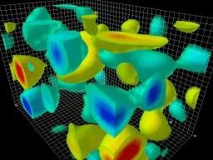
Energy-time Uncertainty Principle
In addition to Heisenberg’s original position-momentum uncertainty principle, quantum mechanics limits the accuracy of other pairs of observable properties. Of particular importance is the energy-time uncertainty principle:
It is better to understand this as limiting the precision we can measure the energy of a quantum state if it has a life-time Δt. This has the implication that it is possible to create energy from nothing for a short period. The startling consequence is that, even in a vacuum, particles (called virtual particles) can be appear spontaneously, as long as they annihilate and disappear on a time scale that doesn’t contravene the uncertainty relation.
Notes:
Could say something about atomic here?
e.g. the Delta-t could be interpreted as uncertainty over the lifetime of a state – hence short-lived excited states naturally produce broadened lines.

Slide 10
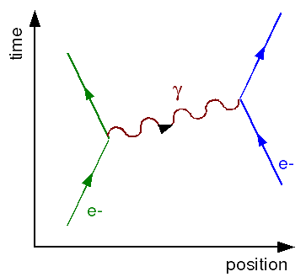
Quantum field theory
In modern quantum field theory, the fundamental forces of nature are understood to be transmitted by particular virtual particles! For example, the electromagnetic force is transmitted by virtual photons.
Notes:
Maybe caution that this is a simplified picture (the real interaction is a sum of all the possible virtual interactions, in some sense)

