Slide 1
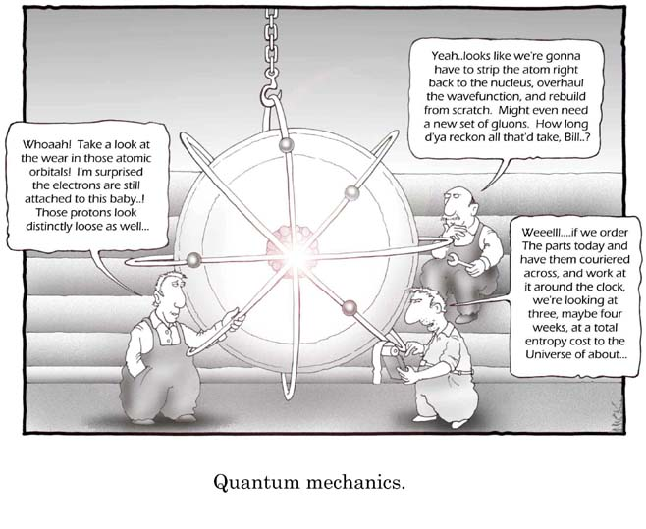
Lecture 4: more quantum strangeness
We meet another example of how quantum mechanics explains phenomena which are observed in nature, but are not allowed by classical physics. We also meet the famous Schrodinger equation.
Notes:
Perhaps start by going back to square well and emphasizing how it agrees with classical, and how it doesn’t.
Emphasise that we are going back to the issue of probabilities (after just dealing largely with energy levels in confined systems).
i.e. back to the whole collapse of the wave function.
Could perhaps talk about Schrodinger’s cat? – and in general the quantum to classical transition.
Perhaps start by saying that the maths is rather abstract – not obviously based on deeper principles – and unsatisfying. Both “simple”, but also quickly complex.
Might comment that underlying all of reality appears to be something that isn’t real (wavefunctions)!!
– links back to Bohr quote from lecture 1
We dealing with these rather artificial systems – but they shouldn’t be disheartened by that. Need to keep in mind that all chemistry, solid state, atomic, nuclear etc. is based on QM!

Slide 2
Travelling waves hitting a step
For example, consider such a wave hitting a potential step where E > U₀. We are interested in the properties of the reflected and transmitted waves.
k
E
U₀
k₁
k₂
Reduced momentum
Notes:
Can compare to light hitting a material of higher refractive index. (e.g. laser, although we are still dealing with matter particles)
Need to make it clear that this analysis is treating waves as continuous (in time and space), so it’s not like a pulse arriving.

Slide 3
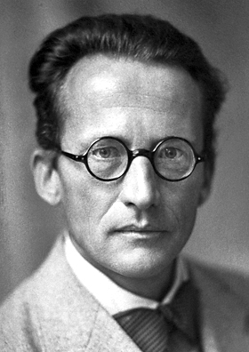
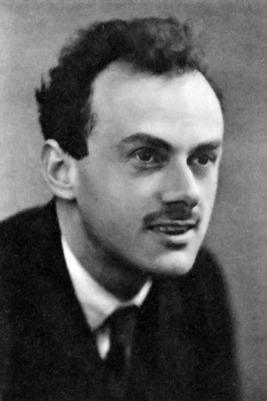
The Schrodinger equation
The Schrodinger equation, discovered in 1926, is a wave equation that determines wave-functions and their time evolution.
It replaces Newton’s classical laws of motion (of course, Newton’s laws are a consequence of quantum mechanical rules when applied to large systems).
Here V is the potential in which the particle moves.
Note: historically, the equivalent (but often less practical) method of matrix mechanics was developed by Heisenberg in 1925 (and both were subsumed into an even more general mathematical scheme by Dirac in 1927, who also went on to develop the relativistic version of quantum theory, and predicted the existence of anti-matter).
Notes:
Emphasise that SE applies to the evolution, not to the collapse. The former is deterministic, the latter not.

Slide 4
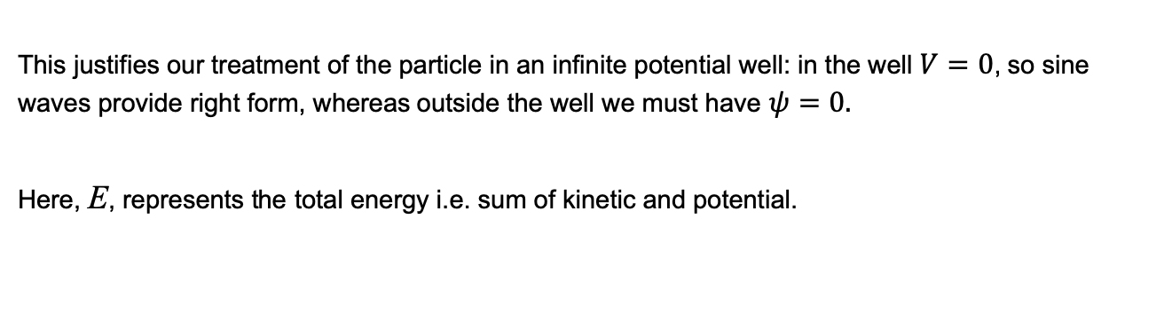
The Schrodinger equation
If the potential does not change in time, then the Schrodinger equation simplifies to its "time-independent” form for the energy of a particle state:
This justifies our treatment of the particle in an infinite potential well: in the well $V=0$, so sine waves provide right form, whereas outside the well we must have $ψ=0.$
Here, E, represents the total energy i.e. sum of kinetic and potential.

Slide 5
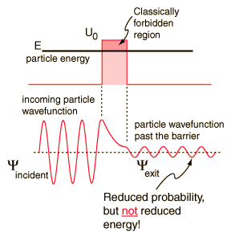
Travelling waves hitting a barrier
Plane waves of fixed momentum are described by wavefunctions ψ (x,t) = Ae^{i(kx -ωt)} where k = 2π /λ is the wavenumber and ω = 2π f is the angular frequency.
An important case we can analyse is that of quantum plane waves hitting a potential barrier. Of particular interest is when the incoming particle(s) have lower energy than the barrier.
Notes:
NB. This is first time we’ve introduced wave-function depending on “time” – so make it clear that’s ok. – requires the complex representation.
Note, normalization of this (idealized, purely wave, totally non-localized) state is not really possible (the particle can be found anywhere with equal likelihood between –infty and infty, before you put the barrier there)
Maybe comment that such a “top hat” kind of barrier is a bit artificial – in real life tend to be dealing with fuzzier things (e.g. coulomb potentials)
Analogy of tennis balls bouncing up to a wall. [this naturally leads to commenting that it really should apply to macroscopic objects!]

Slide 6
Travelling waves hitting a barrier
If barrier has height U₀, then, from Schrodinger equation, within the barrier solution is:
Hence for barrier of width L the amplitude of the wavefunction after the barrier is given by:
Unlike classical particles, even when a quantum wave impinges on a barrier which is higher than the energy of the particle, there is some small probability that the particle “tunnels” through and is found at the other side:
This approximate analysis ignores the reflected wave from the second surface etc.
Logically, the probability of reflection:
Notes:
Could draw analogy of a ball bouncing along towards a wall that is higher than the peak of its trajectory.
Could also point out that tunneling could be understood (somewhat less exactly) just from considering Heisenberg dEdt uncertainty relation – a bit more energy was available for a bit.

Slide 7
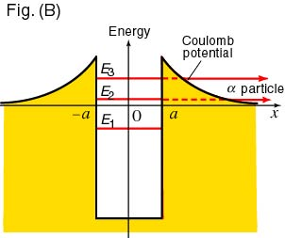
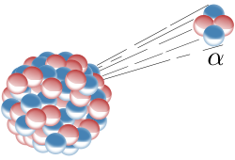
Tunnelling
Tunnelling of this sort can also allow particles to escape from a potential well when the seemingly have insufficient energy. The best known example is that of alpha decay, in which a He nucleus is ejected from a heavier nucleus, despite the strong nuclear forces acting on it.

Slide 8

Tunnelling

Slide 9
Example problem

Slide 10
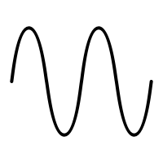
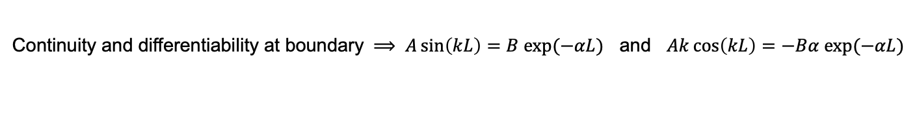

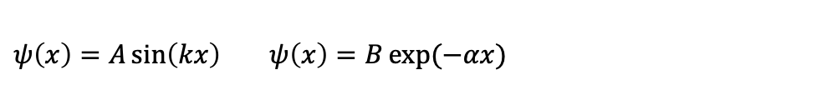
Example problem
$$E$$
$$ψ\left(x\right)=A\sin\left(kx\right) ψ\left(x\right)=B\exp{(−αx)}$$
Continuity and differentiability at boundary $⟹ A\sin\left(kL\right)=B exp(−αL)$ and $Ak\cos\left(kL\right)=−Bα exp(−αL)$

Slide 11

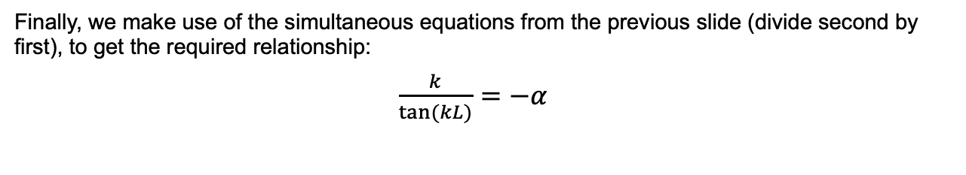
Example problem
Within the well we can double differentiate: $ψ^{′′}(x)=−k^{2}A\sin\left(kx\right)$
Hence use Schrodinger, so find: $E=k^{2}\frac{ℏ^{2}}{2m} ⇒ k=\sqrt{\frac{2mE}{ℏ^{2}}}$
Similarly, outside the well: $ψ^{′′}\left(x\right)=α^{2}B exp\left(−αx\right)$
Hence: $E−V_{0}={−α}^{2}\frac{ℏ^{2}}{2m} ⇒ α=\sqrt{\frac{2m(V_{0}−E)}{ℏ^{2}}}$
Finally, we make use of the simultaneous equations from the previous slide (divide second by first), to get the required relationship:
$\frac{k}{\tan{(kL)}}={−α }^{}$

Slide 12
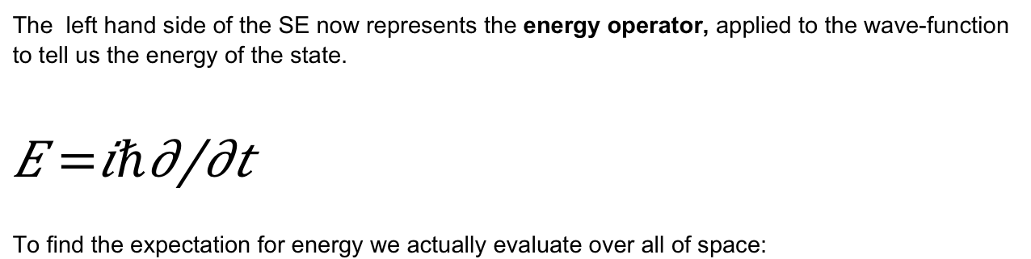
Operator formalism
The left hand side of the SE now represents the energy operator, applied to the wave-function to tell us the energy of the state.
$$\hat{E}=iℏ\frac{∂}{∂t}$$
To find the expectation for energy we actually evaluate over all of space:
Other properties can be determined by applying other differential operators, e.g. momentum operator is:
Notes:
Is this a good time to emphasise the philosophy behind QM – essentially the rules and interpretation of equations are cooked up to agree with reality (maybe all of physics is)

Slide 13
The Schrodinger equation
The Schrodinger equation, discovered in 1926, is a wave equation that determines wave-functions and their time evolution.
It replaces Newton’s classical laws of motion (of course, Newton’s laws are a consequence of quantum mechanical rules when applied to large systems).
Here V is the potential in which the particle moves.

Slide 14
Schrodinger equation
As with problems in classical physics, we can usually only exactly solve quantum mechanical problems in special or simplified cases. It can be onerous, though, to produce even approximate solutions to complicated situations.
The simplest systems we can analyse are those involving single particles evolving in a simple potential (the electron orbiting in the Hydrogen atom is an obvious example!).
Notes:
Is this a good time to emphasise the philosophy behind QM – essentially the rules and interpretation of equations are cooked up to agree with reality (maybe all of physics is?).
Can also comment that Schrodinger introduced equation thinking that the wavefunctions would be understood as real things, and when he realised they were waves of probability (and hence abstract), he rather renounced it.
NB. Applies to material particles – not strictly photons.

