Slide 1
PA1140: WAVES AND QUANTA Unit 4: Atoms and nuclei
Lecturer: Prof Nial Tanvir (G20)
nrt3@le.ac.uk

Slide 2
Reading
Chapter 36 (36-1 to 36-2) & 40 in Tipler 6th edition

Slide 3
Overview
Atomic physics (the pre-1925 QM viewpoint)
The Atom
Atomic Spectra
The Bohr Model
Nuclear Physics
Properties of Nuclei
Mass and Binding Energy
Radioactivity (including some applications)
Nuclear Reactions
Fission
Fusion

Slide 4
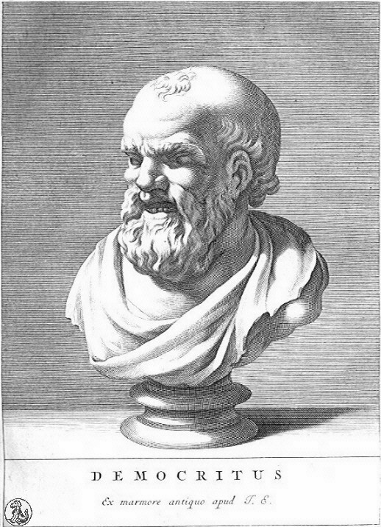
Lecture 1: the atom
Scientific evidence that matter was made up of atoms accumulated during the 19th century, but it was not until the early 20th century that physicists made progress in understanding their internal nature.
I think you’ll find that I said it first: I even invented the name “atomos” ($ατομοζ)$, meaning “indivisible”.

Slide 5
Reminder of some terminology
Atomic number ($Z$): number of protons
Matches location on periodic table $Z$ = 1 for hydrogen $Z$ = 2 for helium $Z$ = 3 for lithium etc.
Number of protons = number of electrons (for uncharged atoms)
Nucleus: comprised of protons and neutrons (radius = 1-10 fm)
Nuclear charge: $+Ze$ (where $e$ = 1.60217662×10⁻¹⁹ C is the elementary charge)
Ions: charged atoms that have gained or lost an electron
Notes:
Atomic number: Z = number of protons that equals number of electrons
Nucleus: made of protons and neutrons

Slide 6
Atomic Spectra
Each atom emits a unique light spectrum (fingerprint of an atom)
Observed emission spectra of atoms:
19th century researchers found mathematical expressions that reproduced some if these patterns, but no deeper explanations.

Slide 7
Atomic Spectra
Johann Balmer determined the following expression for wavelengths of lines in the visible (400-800 nm) spectrum for hydrogen:
$$λ=\left(364.6 nm\right)\left(\frac{m^{2}}{m^{2}−4}\right)$$
where $m$ = 3, 4, 5,….
The Rydberg-Ritz formula provided a more general expression for “hydrogen-like” atoms/ions, and across a wider wavelength range:
where:
$n_{1}$ and $n_{2}$are integers
$$n_{1} >n_{2}$$
$R$: different for each element
$$\frac{1}{λ}=R\left(\frac{1}{n_{2}^{2}}−\frac{1}{n_{1}^{2}}\right)$$
R _{H} = 1.097 x 10⁷ m⁻¹ for hydrogen (the Rydberg constant)
The two are consistent for R = R_{H}, n₂ =2, and n₁ = m
Notes:
Hydrogen-like here means either a single electron, or (more approximate) single electron in outer shell.

Slide 8
Models of the Atom:
Thomson’s Plum Pudding Model
Electrons embedded in a fluid that has a distributed positive charge:
fluid of positive charge
negative electrons
Disproved by his student (Rutherford) who showed that most of the mass of an atom is concentrated in the nucleus

Slide 9
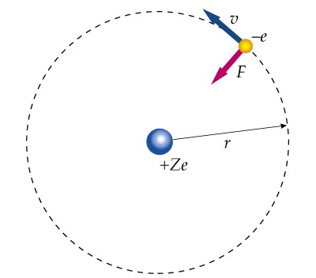
Models of the Atom: The Bohr Model
Structure similar to planets orbiting the sun: electron moves in a circular/elliptical orbit around a positive nucleus:
ν: speed
–$e$: charge of electron
$F$: attractive electric force
$r$: radius
+Z$e$: charge of nucleus
Notes:
F = mv2/r (centripetal force)

Slide 10
The Bohr Model
Centripetal force acting on the orbiting electron is the electrostatic force of attraction (Coulomb force):
Attractive electrical force:
$$F=\frac{k\left|q_{1}q_{2}\right|}{r^{2}}$$
where $k$ = 8.99 x 10⁹ N m² C⁻² (Coulomb’s constant)
$$F=\frac{kZe^{2}}{r^{2}}=\frac{mυ^{2}}{r}$$
Keeps the electron in its orbit

Slide 11
Energy for a Circular Orbit
Potential energy ($U$) of electron of charge –$e$ at distance $r$ from nucleus of positive charge $Ze$:
$$U=\frac{kq_{1}q_{2}}{r}=\frac{k(Ze)\left(−e\right)}{r}=−\frac{kZe^{2}}{r}$$
To find kinetic energy ($K$), set Coulomb attractive force equal to centripetal force:
$$\frac{kZe^{2}}{r^{2}}=m\frac{ν^{2}}{r}$$
Multiply both sides by $r/2$:
$$K=\frac{1}{2}mν^{2}=\frac{kZe^{2}}{2r}$$

Slide 12
We see that U and K vary inversely with r, and U is twice K:
$U = –2K$
This is a general result for orbiting particles with $F ∝ 1/r2$
Therefore, total energy in a circular orbit is:
$$E=K+U=−\frac{1}{2}\frac{kZe^{2}}{r}$$

Slide 13
Why The Bohr Model should fail
Mechanically stable: Coulomb attractive force provides centripetal force to keep electron in orbit.
Electronically unstable: Electron must accelerate (change direction and velocity) when moving in a circle and so should emits electromagnetic radiation of frequency equal to its orbital motion. Hence should lose energy, and rapidly spiral into the nucleus.
[Source: M. Strassler, 2013]
So, the atom could not exist using this model.

Slide 14
Rescuing the Bohr model
So Bohr made three radical assumptions (postulates) to rescue the model:
1st Postulate. Electron in hydrogen atom can only move in certain non-radiating, circular orbits called stationary states
2nd Postulate. An electron can make a transition from a stationary state of higher energy, $E_{2}$, to a state of lower energy, $E_{1}$, leading to emission of a photon of frequency f.
$$f=\frac{E_{i}−E_{f}}{h}=\frac{∆E}{h}$$
where $h$ = 6.626 x 10⁻³⁴ m² kg s⁻¹ (Planck’s constant; equivalent to units of J s)
We can use the total energy expression from earlier to obtain an expression for $f$ in terms of $r_{f}$ and $r_{i}$:
$$f=\frac{E_{i}−E_{f}}{h}=\frac{1}{2}\frac{kZe^{2}}{h}\left(\frac{1}{r_{f}}−\frac{1}{r_{i}}\right)$$

Slide 15
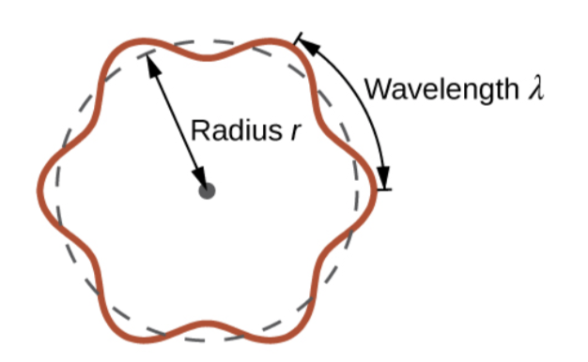
Quantisation of angular momentum
3rd Postulate. Only those orbits are allowed for which angular momentum of an electron is an integer multiple of $h/{2π}$ (i.e. discrete values or ${nh}/{2π}$).
$$ℏ=\frac{h}{2π}=1.055×{10}^{−34}Js=6.582×{10}^{−16} eV s$$
where $ℏ$ is the reduced Planck’s constant
The angular momentum of a circular orbit is $mνr$, so:
where $n$ = 1, 2, 3,…. (the quantum number of the state)
$$mν_{n}r_{n}=nℏ$$
Notice, this means the de Broglie wavelengths of the electron have to fit in orbits like standing waves, since
$${2πr}_{n}=\frac{nh}{p_{n}} ⟹ {2πr}_{n}=nλ$$
Notes:
Angular momentum, L = mvr

Slide 16
Radii of Bohr Orbit
Considering the central force equation we wrote down above, velocity is given by:
$$v_{n}=\sqrt{\frac{kZe^{2}}{mr_{n}}}$$
$$r_{n}=\frac{n^{2}ℏ^{2}}{mkZe^{2}}$$
And radius:
$${⟹r}_{n}=n^{2}\frac{a_{0}}{Z}$$
where $r_{n}$ is the radius of orbit n
$a_{0}$ is the first Bohr radius (orbital radius of the electron of a hydrogen atom that has $n=1)$
$$a_{0}=\frac{ℏ^{2}}{mke^{2}}=\frac{ℇ_{0}h^{2}}{πme^{2}}=0.0529 \text{nm}$$

Slide 17
Atomic Energy Levels
Total mechanical energy of a hydrogen atom ($Z=1$) is related to the radius of a circular orbit, so we can obtain an expression for the energy of orbit $n$ for hydrogen.
$$E_{n}=−\frac{1}{2}\frac{mk^{2}Z^{2}e^{4}}{n^{2}ℏ^{2}}=−Z^{2}\frac{E_{0}}{n^{2}}$$
If Z = 1, E_{n} are the quantized allowed electron energy levels for hydrogen
where: $n$ = 1, 2, 3,…., and
$$E_{0}=\frac{mk^{2}e^{4}}{2ℏ^{2}}=\frac{1}{2}\frac{ke^{2}}{a_{0}}=13.6 eV$$

Slide 18
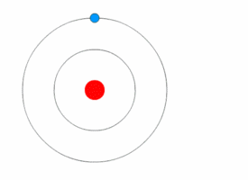
Electron transitions
Transitions between allowed energies result in emission or absorption of a photon with frequency:
$$f=\frac{E_{i}−E_{f}}{h}$$
And of wavelength, $λ$, of:
$$λ=\frac{c}{f}=\frac{hc}{E_{i}−E_{f}}$$
where $hc=1240 \text{eV} \text{nm}$
$f$ and $λ$ of emitted and absorbed radiation are quantized (consistent with the observed line spectrum).

Slide 19
Frequency of spectral lines
Plugging in the expression for the allowed energies, we obtain the Rydberg (or Rydberg-Ritz) formula (a big success for Bohr!):
$$f=\frac{mk^{2}Z^{2}e^{4}}{4πℏ^{3}}\left(\frac{1}{n_{f}^{2}}−\frac{1}{n_{i}^{2}}\right)$$
Using this and the relationship between frequency and wavelength ($f=c/λ$) and $Z=1$ for hydrogen we obtain the Rydberg constant ($RH$) in terms of other fundamental constants:
$$R_{H}=\frac{mk^{2}e^{4}}{4πℏ^{3}c}=\frac{me^{4}}{8ε_{0}^{2}h^{3}c}$$
The value agrees with that obtained from spectroscopy!

Slide 20
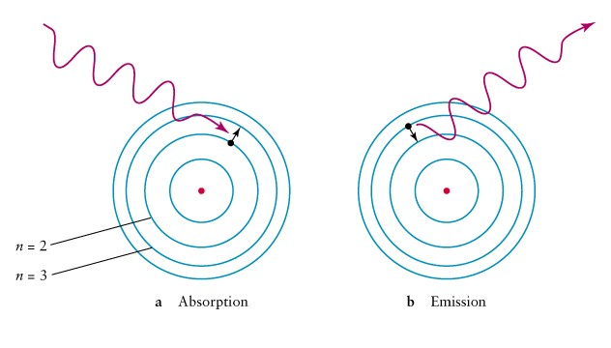
Quantized Energy Transitions
Electron transitions from lower to higher state
(requires energy)
Electron transitions from higher to lower state
(releases energy)

Slide 21
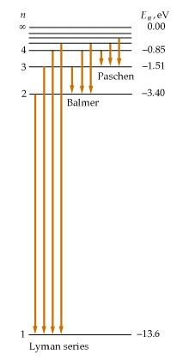
Energy Transitions of Hydrogen
$E_{1}=−13.6 \text{eV}$ (ground state or lowest energy state of hydrogen)
As $n→∞$, $E_{n}→0$ (as $E_{n}∝1/{n^{2}}$)
Negative to indicate that energy is needed for electron to transition from lower to higher orbit
Energy-level diagram shows transitions from higher to lower states (emission lines):
Lyman lines: $n_{f}=1; n_{i}=2, 3, 4,…$
Balmer lines: $n_{f}=2; n_{i}=3, 4, 5,…$
Paschen lines: ${ n}_{f} =3; n_{i}=4, 5,6,…$
Arrows would be in opposite direction for absorption

Slide 22
Electron Removal
Ionization: removal of one electron from an atom
Ionization energy (or binding energy): minimum energy required to remove an electron

Slide 23
Energy Transitions
Able to reproduce the observed hydrogen spectrum with Bohr’s model:
Reproduce the observed spectrum:

Slide 24
Issues with the Bohr Model
No justification for the assumption of stationary states
No justification for the assumption of quantization of angular momentum
Model not really applicable for atoms with more electrons and protons
The fully quantum-mechanical model resolves these issues (next year!)

