Slide 1
PA1140: WAVES AND QUANTA Unit 4: Atoms and nuclei
Lecturer: Prof Nial Tanvir (G20)
nrt3@le.ac.uk

Slide 2
Properties of Nuclei
Nuclear Radii:
$$R=R_{0}A^{1/3}$$
Binding Energy:
$$E_{b}=\left(ZM_{H}+NM_{N}−M_{A}\right)c^{2}$$
Radioactivity
Exponential Decay of a Radioactive Sample:
$$N=N_{0}e^{−λt}$$
Decay Rate or Activity of a Sample:
$$R=R_{0}e^{−λt}$$

Slide 3
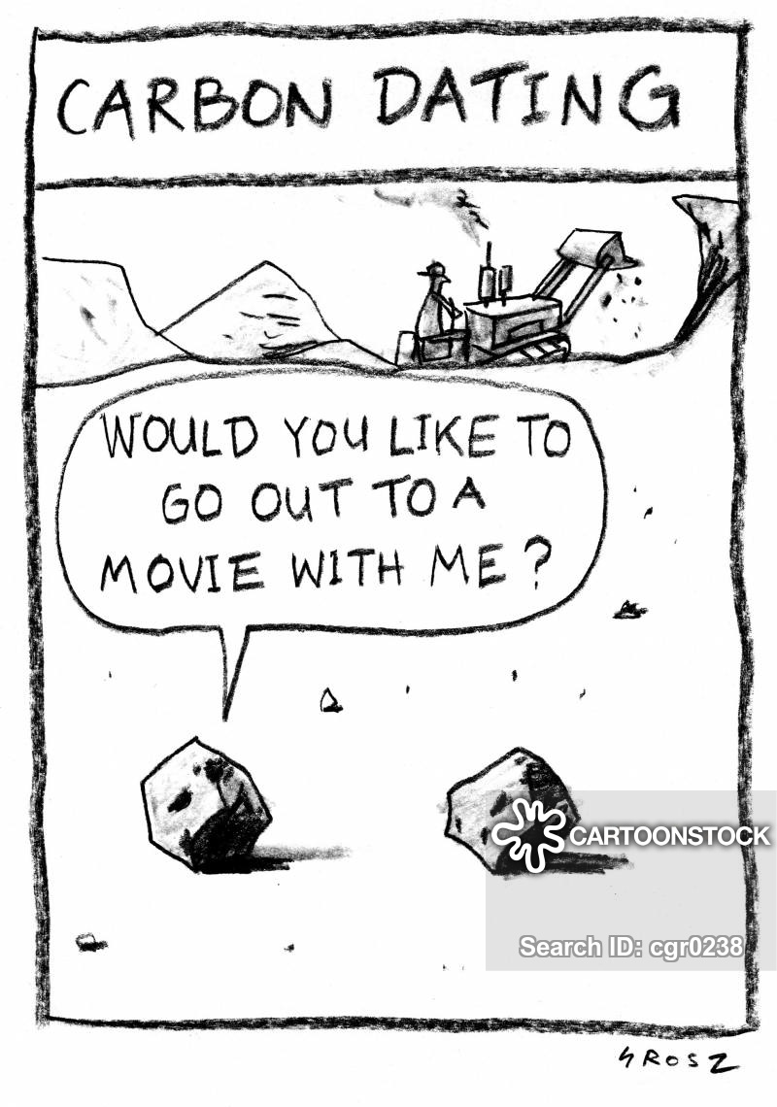
Lecture 3: radioactivity (cont…)

Slide 4
Lifetime
The mean lifetime, $τ$, of a sample is the reciprocal of the decay constant:
$$τ=\frac{\int_{0}^{∞}{te^{−λt}dt}}{\int_{0}^{∞}{e^{−λt}}dt}=\frac{{\left[\frac{{−te}^{−λt}}{λ}−\frac{e^{−λt}}{λ^{2}}\right]}_{0}^{∞}}{{\left[{−e}^{−λt}/λ\right]}_{0}^{∞}}=\frac{1}{λ}$$
After a time equal to the mean lifetime ($τ$):
$$N=e^{−1}N_{0}=0.37N_{0}$$
N and R are 37% of their original values
$$R=e^{−1}R_{0}=0.37R_{0}$$
Lifetime ($τ$) is also referred to as the e-folding time

Slide 5
Half-life
Half-life, $t_{1/2}$, is the time it takes for the number of nuclei (the sample) and the decay rate to decrease by half:
$$N=\frac{N_{0}}{2}$$
$$R=\frac{R_{0}}{2}$$
We can obtain an expression for $t_{1/2}$ in terms of the decay constant:
$$N_{0}e^{−λt_{1/2}}=\frac{N_{0}}{2} ⇒ λt_{1/2}=ln⁡(2)$$
$$t_{1/2}=\frac{ln(2)}{λ}=τln(2)=0.693τ$$

Slide 6
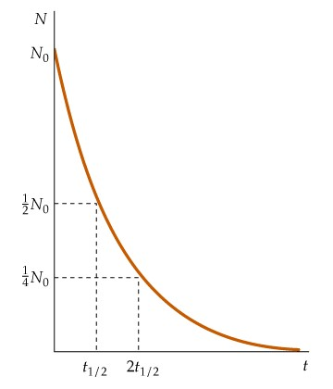
Half-life
Number of particles vs time
After each half-life, the number of remaining nuclei have decreased by half.
The decay rate $R=λN$ has the same dependence as N.
Obtain same plot to show R by multiplying the y-axis by $λ$.
$$\frac{N_{0}}{e}$$
$$τ$$

Slide 7
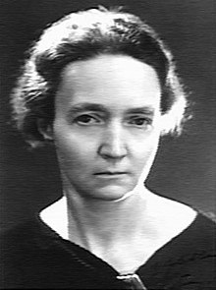
Half-life
We can obtain a general expression for the decay rate after $n$ half-lives:
$$R_{n}={\left(\frac{1}{2}\right)}^{n}R_{0}$$
Half-lives vary from ~1 μs for very unstable nuclei to ~10¹⁰ y for very stable nuclei
SI unit of radioactive decay: becquerel (Bq):
(1 Bq = 1 decay s⁻¹)
Historical unit is the curie (Ci):
1 Ci = 3.7 x 10¹⁰ decays/s = 3.7 x 10¹⁰ Bq (i.e. the rate at which radiation is emitted by 1 g of radium)

Slide 8
Beta Decay
Occurs for parent nuclei with too many or too few neutrons for stability (e.g. nitrogen-13 from lightning or carbon-14 from cosmic rays).
Involves conversion of neutron into proton plus electron (plus anti-neutrino). Here the electron is ejected and referred to as a β particle.
[The decay of a proton into a neutron, positron and neutrino is referred to as beta-plus decay]
Leads to change in nuclide type, with the new nuclide having a more stable ratio of protons and neutrons.
The β particles and neutrinos don’t exist in the nucleus, but are created in the decay process.
Energy of β decay is ~0.782 MeV (the difference between the rest energy of a neutron and the rest energy of a proton and electron)
Notes:
Ask them: does carbon-14 have too many or too few neutrons?
How about magnesium-23?

Slide 9
Beta Decay
Beta minus decay:
$β$ minus decay
Beta plus decay:
$β$ plus decay
proton neutron
β minus | β plus
Neutron → proton | Proton → neutron
Electron & antineutrino emitted | Positron & neutrino emitted
N decreases; Z increases | N increases; Z decreases

Slide 10
Beta Decay
Via what $β$-decay will carbon-14 and magnesium-23 decay?
What are the decay products?
$${}_{6}^{14}C→{}_{7}^{14}N+e^{−}+{\overline{ν}}_{e}$$
$${}_{12}^{23}{Mg}→{}_{11}^{23}{Na}+e^{+}+ν_{e}$$

Slide 11
Beta Decay
Via what $β$-decay will carbon-14 and magnesium-23 decay?
What are the decay products?
$${}_{6}^{14}C→{}_{7}^{14}N+e^{−}+{\overline{ν}}_{e}$$
$${}_{12}^{23}{Mg}→{}_{11}^{23}{Na}+e^{+}+ν_{e}$$

Slide 12
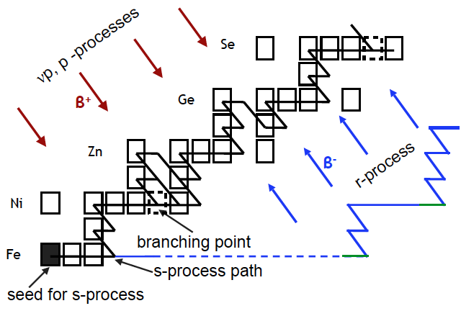
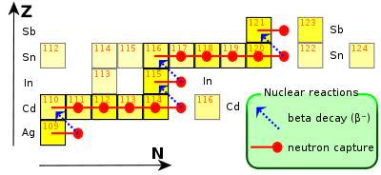
Creating heavy elements
Elements heavier than iron are thought to be mainly built up via neutron capture on seed nuclei (occurs in various, rare astrophysical situations).
Some atomic species seem to be formed instead by a “rapid” or “r-process” in which highly unstable, neutron rich nuclei are initially formed more rapidly than they can decay via $β$-decay. (This may occur predominantly in colliding neutron stars!)
Many elements are created by the so-called “slow” or “s-process”, where $β$-decays occur when unstable nuclei have been formed.

Slide 13
Application of β decay: Radiocarbon Dating
Commonly used to determine the age of an object containing organic material. We already know the decay products of ¹⁴C:
$${}_{6}^{14}C→{}_{7}^{14}N+e^{−}+{\overline{ν}}_{e}$$
$t_{1/2}$ for this decay is 5730 years
Should expect concentration of ¹⁴C to decrease over time, but it is generated via reaction between ¹⁴N and a neutron:
$$\text{n}+{}_{7}^{14}N→{}_{6}^{14}C+\text{p}$$
n = neutron; p = proton
¹⁴N is abundant in the Earth’s atmosphere (~79% of air)
What is the neutron source?
Notes:
Atomic number: Z = number of protons that equals number of electrons
Nucleus: made of protons and neutrons

Slide 14
Application of β decay: Radiocarbon Dating
Cosmic rays
$$\text{n} +{}_{7}^{14}N→{}_{6}^{14}C+\text{p}$$
High-energy radiation originating from the Sun or outside our solar system.
Composed mostly of protons and α particles (⁴He) that are converted to neutrons and other particles when they collide with atoms and molecules in the Earth’s atmosphere
Reaction to form ¹⁴C occurs mostly 9-15 km overhead (upper troposphere/lower stratosphere and aircraft cruising altitude)
Notes:
Atomic number: Z = number of protons that equals number of electrons
Nucleus: made of protons and neutrons

Slide 15
Application of β decay: Radiocarbon Dating
¹⁴C and ¹²C (the most abundant carbon isotope) have the same reactivity
¹⁴C and ¹²C react with oxygen (O₂) in the atmosphere to form carbon dioxide (¹²CO₂ from ¹²C and ¹⁴CO₂ from ¹⁴C)
The relative abundance of ¹⁴CO₂ and ¹²CO₂ (¹⁴CO₂/¹²CO₂) is ~1.3 x 10⁻¹²
Living organisms like plants continually exchange CO₂ with the atmosphere, so have the same ratio of ¹⁴CO₂-to-¹²CO₂):
Photosynthesis
Respiration
Carbon assimilation during the day
Respire CO₂ at night (and during the day)
Notes:
Atomic number: Z = number of protons that equals number of electrons
Nucleus: made of protons and neutrons

Slide 16
Application of β decay: Radiocarbon Dating
Animals eat the plants, animals eat the animals that ate the plants… and so on up the food chain so that radiocarbon becomes distributed throughout the biosphere.
When these organisms die, they no longer take up ¹⁴C, so ¹⁴C/¹²C decreases (¹²C is stable, ¹⁴C undergoes β decay)
Some samples have been reliably measured are ~50,000 years old (~8 half-lives)
Notes:
Atomic number: Z = number of protons that equals number of electrons
Nucleus: made of protons and neutrons

Slide 17
Application of β decay: Radiocarbon Dating

Slide 18
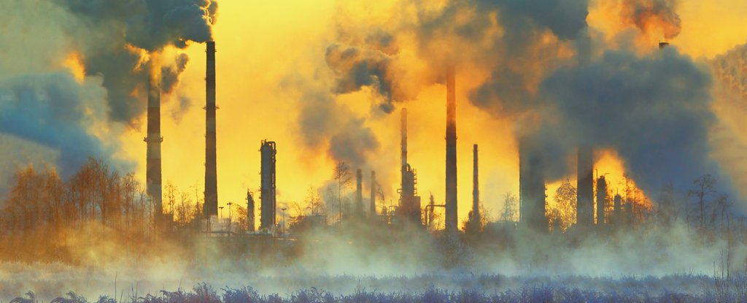
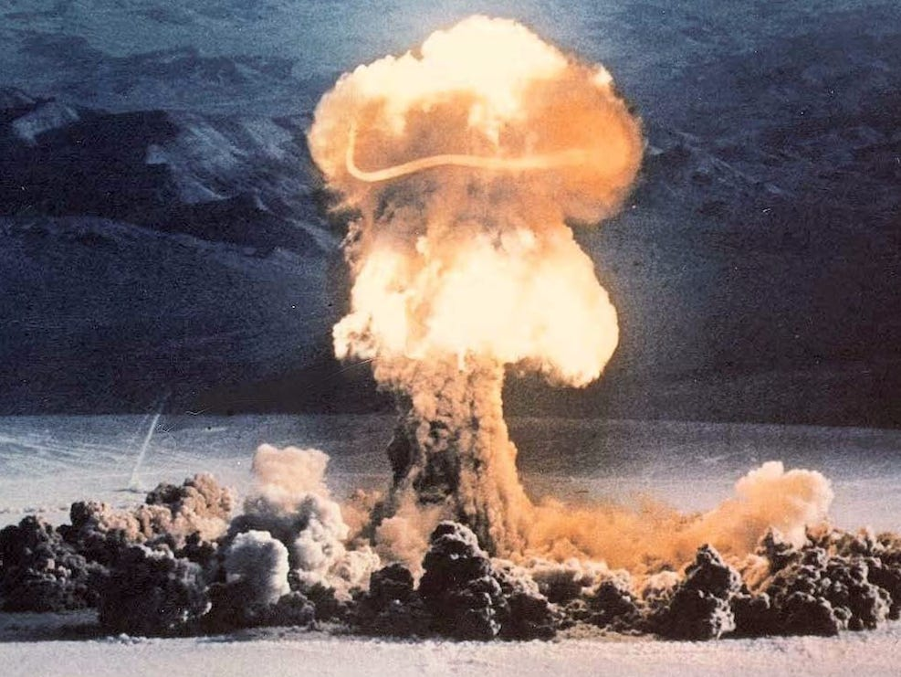
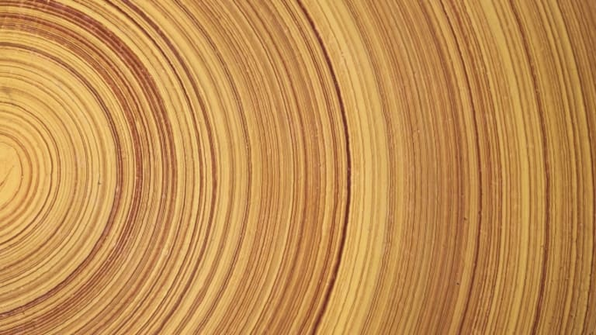
Our Impact on Radiocarbon Dating
We are adding CO₂ to the atmosphere from burning fossil fuels (coal, natural gas, oil that are millions of years old).
This affects the relative abundance of ¹⁴C:¹²C since it adds ¹²C.
However, we have also added ¹⁴C as a by-product of nuclear bomb testing.
In practice, precision use of carbon dating relies on further calibration, for example trees can be both carbon dated and their ages estimated using tree rings (think about it!).

Slide 19
Practice Problems: Carbon Dating
(a) A non-living wood sample contains 10 g of carbon and shows a ¹⁴C decay rate of 100 counts/min. (“Counts” being the number of decays). How old is it? The activity of a living carbon-containing organism is about 15 decays per minute per gram of carbon and the half-life of ¹⁴C is 5730 years
(b) What decay rate would you expect from 15 g of 10,000 year-old wood?

Slide 20
Practice Problems: Carbon Dating
(a) A non-living wood sample contains 10 g of carbon and shows a ¹⁴C decay rate of 100 counts/min. (“Counts” being the number of decays). How old is it? The activity of a living carbon-containing organism is about 15 decays per minute per gram of carbon and the half-life of ¹⁴C is 5730 years
If only just died, expect 150 cts/min. Also e-folding time $τ=\frac{t_{1/2}}{\ln\left(2\right)}=8270 y$
$$R=R_{0}\exp\left(−\frac{t}{τ}\right) ⇒ t=−τ\ln\left(\frac{R}{R_{0}}\right) =3350 y$$
(b) What decay rate would you expect from 15 g of 10,000 year-old wood?
Here, $R_{0}=225 cts \min^{−1}$, so $R=R_{0}\exp\left(−\frac{t}{τ}\right)=67 cts \min^{−1}$

Slide 21
Practice Problems: Carbon Dating
(a) A non-living wood sample contains 10 g of carbon and shows a ¹⁴C decay rate of 100 counts/min. Counts is the number of decays. How old is it? The activity of a living carbon-containing organism is about 15 decays per minute per gram of carbon and the half-life of ¹⁴C is 5730 years
Answer: 3352 years
(b) What decay rate would you expect from 15 g of 10,000 year-old wood?
Answer: 67 min⁻¹

Slide 22
Alpha Decay
Tends to occur for very heavy nuclei (Z > 83) (and where N > Z)
Coulomb repulsion between protons so great that becomes unstable
⟾ Daughter nucleus mass number A is reduced by 4 relative to parent nucleus (removal of an $α$ particle or ⁴He – which tunnels out from the nuclear potential!).
Example:
$$232Th→228Ra+α=228Ra+4\text{He}$$
Mass of the parent nucleus exceeds mass of decay products (daughter nucleus and $α$ particle)
Use the mass difference between reactants and products to calculate binding energy (E_{b} ; lecture 2)
Notes:
Atomic number: Z = number of protons that equals number of electrons
Nucleus: made of protons and neutrons

Slide 23
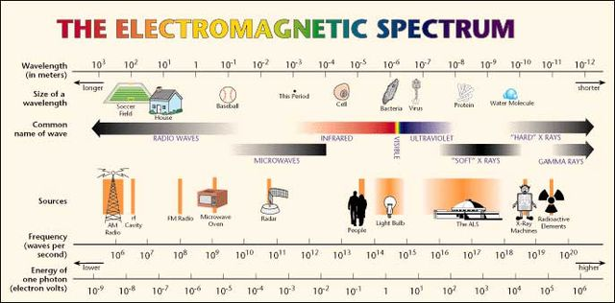
Gamma Decay
Nucleus in an excited state decays to a lower energy state by emitting a photon
⟾ A and Z remain the same
Spacing of nuclear energy levels is of the order 1 MeV, so wavelength of emitted photons are order 1 pm (10⁻¹² m)
$$λ=\frac{hc}{∆E}$$
Notes:
Atomic number: Z = number of protons that equals number of electrons
Nucleus: made of protons and neutrons

Slide 24
Gamma Decay
Gamma decay often occurs after $α$ or $β$ decay
Radioactive parent nucleus decays by $β$ decay to excited state, then daughter nucleus decays to its ground state by $γ$ emission
Lifetime of nuclei that undergo $γ$ decay is very short (10⁻¹¹ s is possible)
Example of$γ$ decay:
$${}_{53}^{125}{I\text{∗}}→{}_{53}^{125}I+γ$$
* denotes isotope in an excited state
Gamma rays given off during nuclear fission (nuclear reactors and nuclear explosions).
Gamma rays also come from interaction of the Earth’s atmosphere with cosmic rays.
Gamma rays are ionizing and so are biologically hazardous (can pass through the body, so pose a shielding challenge in nuclear reactors)

