Slide 1
PA1140: WAVES AND QUANTA Unit 4: Atoms and nuclei
Lecturer: Prof Nial Tanvir (G20)
nrt3@le.ac.uk

Slide 2
Lecture 3 Recap

Slide 3
PA1140 Waves & Quanta. Unit 4: Atoms & Nuclei
Radioactivity
Decay Rate or Activity of a Sample after n half-lives:
$$R_{n}={\left(\frac{1}{2}\right)}^{n}R_{0}$$
Lifetime or e-folding time:
$$τ=\frac{1}{λ}$$
Half-life:
$$t_{1/2}=0.693τ$$

Slide 4
PA1140 Waves & Quanta. Unit 4: Atoms & Nuclei
Radioactive Decay
Beta Decay:
Conversion of proton to neutron (β plus) or neutron to proton (β minus)
Used to determine age of organic material (radiocarbon dating)
Gamma Decay:
Excited state nucleus decays to ground state
Alpha Decay:
Decay of heavier nuclei leading to formation of ⁴He and A of daughter nucleus reduced by 4 relative to parent nucleus

Slide 5
PA1140 Waves & Quanta. Unit 4: Atoms & Nuclei
Nuclear Reactions
Energy released or absorbed during a nuclear reaction:
$$Q=−∆mc^{2}$$
$Q$ > 0: exothermic
$Q$ < 0: endothermic
Fission:
Heavy nucleus reacts with neutron and breaks apart into two medium-mass nuclei
Fusion:
Two light nuclei fuse together to form a nucleus of greater mass

Slide 6
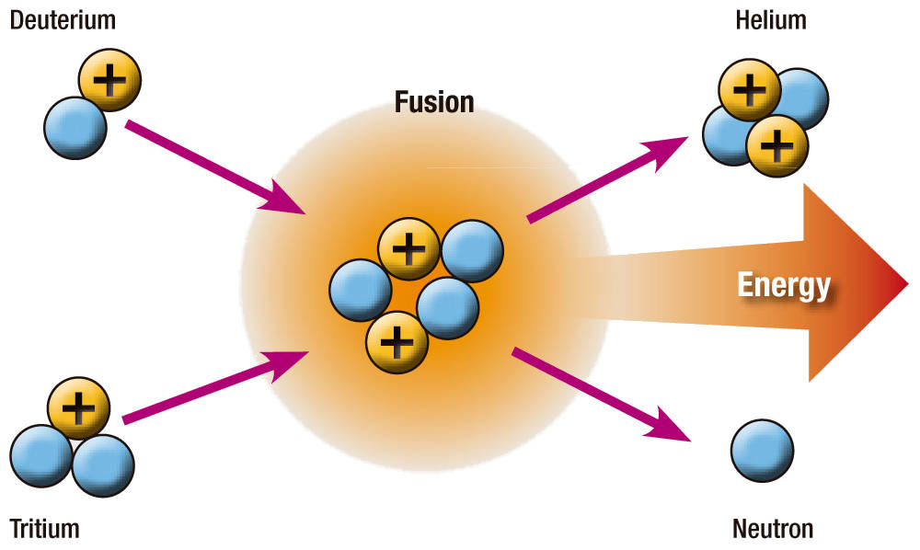
Lecture 4: nuclear reactions, fission & fusion
Apart from decays producing radioactivity, there are a wide range of other nuclear reactions that can take place, particularly in accelerator or astrophysical contexts. We will consider some general issues, and focus particularly on fission and fusion.

Slide 7
Nuclear Reactions
Two nuclei or a nucleus and subatomic particle (proton, neutron) collide to produce one or more new nuclides
Q value: amount of energy released or absorbed during a nuclear reaction:
$$Q=−∆mc^{2}$$
where $∆m=mass of products −mass of reactants$
Energy$Q$ often appears in the nuclear reaction formula e.g.
$$Q>0$$
Exothermic reaction: energy is released
$$Q<0$$
Endothermic reaction: energy is required
Notes:
Caution that Q-value sometimes called Q-factor (but not same as Quality factor of oscillator)

Slide 8
Example Problem: Q Value
Find the $Q$ values for the reactions below.
Are these exothermic or endothermic?
$$10B+n→4He+7\text{Li}+Q$$
Masses from Tipler Table 40-1
¹H = 1.007825 u
n = 1.008665 u
²H = 2.014102 u
³He = 3.016030 u
⁴He = 4.002603 u
⁷Li = 7.016004 u
¹⁰B =10.012939 u
Reminder:
$$\left(1u\right)c^{2}=931.5 \text{MeV}$$
Notes:
Answer for B: -2.79 MeV

Slide 9
Example Problem: Q Value
Find the $Q$ values for the reactions below.
Are these exothermic or endothermic?
$$Q=931.5×\left(2×2.014102−3.01603−1.007825\right)$$
$=4.05$MeV (Exothermic)
$$10B+n→4He+7\text{Li}+Q$$
$$Q=931.5×\left(10.012939+1.008665−4.002603−7.016004\right)$$
$=−2.78$MeV (Endothermic)
Notes:
Answer for B: -2.79 MeV

Slide 10
Practice Problem: Q Value
Find the $Q$ values for the reactions below.
Are these exothermic or endothermic?
Answer: Q = 4.05 MeV (exothermic)
$$10B+n→4He+7\text{Li}+Q$$
Answer: Q = -2.78 MeV (endothermic)
Notes:
Answer for B: -2.79 MeV

Slide 11
Fission
Phenomenon where a very heavy nucleus breaks apart into medium-mass (lighter) nuclei, releasing energy.
Fission occurs when the excitation energy produced when a nucleus captures a neutron exceeds the critical energy (minimum energy needed for fission to occur)
This is why ²³⁵U undergoes fission, but ²³⁸U does not:
$236U$ critical energy: 5.3 MeV
$235U+\text{n}$ excitation energy: 6.4 MeV
Excitation > critical, therefore fission occurs
$239U$ critical energy: 5.9 MeV
$238U+\text{n}$ excitation energy: 5.2 MeV
Excitation < critical, so fission won’t occur
Notes:
For fission to occur, the excitation energy must be above a particular value for certain nuclide
The minimum excitation energy required for fission to occur is known as the critical energy (E_{crit}) or threshold energy.T

Slide 12
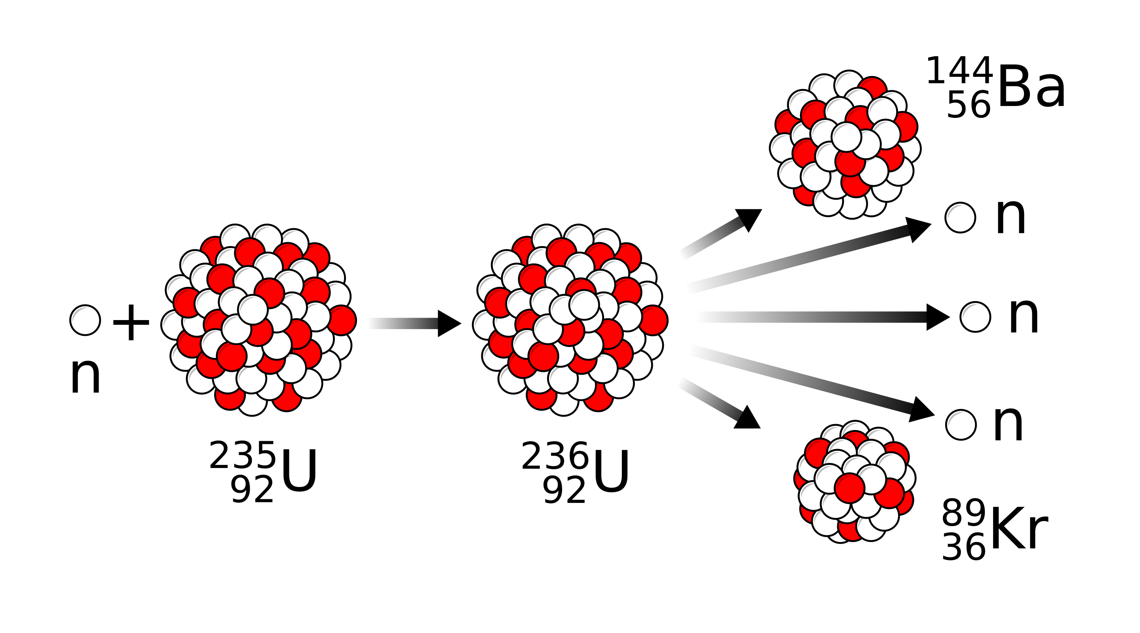
Fission
Occurs when a very heavy nucleus breaks apart into medium-mass (lighter) nuclei, releasing energy.
Fission occurs when the excitation energy produced when a nucleus captures a neutron exceeds the critical energy (minimum energy needed for fission to occur)
This is why ²³⁵U undergoes fission, but ²³⁸U does not:
$236U$ critical energy: 5.3 MeV
$235U+\text{n}$ excitation energy: 6.4 MeV
Excitation > critical, therefore fission occurs
$239U$ critical energy: 5.9 MeV
$238U+\text{n}$ excitation energy: 5.2 MeV
Excitation < critical, so fission won’t occur
Notes:
For fission to occur, the excitation energy must be above a particular value for certain nuclide
The minimum excitation energy required for fission to occur is known as the critical energy (E_{crit}) or threshold energy.T

Slide 13
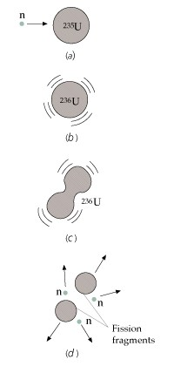
Fission of uranium-235 (²³⁵U)
Absorption of neutron by ²³⁵U
Forms ²³⁶U in an excited state
Oscillation of ²³⁶U becomes unstable
Nucleus splits into 2 nuclei and neutrons are emitted that initiate further fission (chain reaction ensues)
Coulomb repulsion force drives fragments apart
Typical fission reaction:
$$n+235U→141Ba+92\text{Kr}+3\text{n}$$
Notes:
Atomic number: Z = number of protons that equals number of electrons
Nucleus: made of protons and neutrons

Slide 14
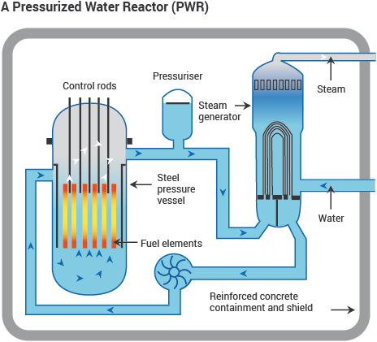
Fission of uranium-235 (²³⁵U) (contd)
Fission reactors typically drive generators, turning heat into electricity in conventional way. Control rods are used to keep the energy generation stable, by absorbing neutrons and so limiting the chain reaction.

Slide 15
Fission of uranium-235 (²³⁵U) (contd)
Chernobyl disaster (1986): Nuclear explosion due to runaway chain reaction

Slide 16
Fusion
Two light nuclei fuse together to form a nucleus of greater mass. This is the primary energy source in stars.
Example:
$$2H+3H→4He+\text{n}+17.6 \text{MeV}$$
Promising source of energy:
High efficiency - greater amount of energy produced per unit mass of fuel than fission.
Abundance of light nuclei – plenty of hydrogen in water!
Less dangerous than fission reactors – although the reactor tends to become radioactive, particularly due to the neutrons released, the amount of radioactive waste is typically much less than in fission.
Notes:
Atomic number: Z = number of protons that equals number of electrons
Nucleus: made of protons and neutrons

Slide 17
Fusion (contd)
Technology not yet a reality for commercial electricity generation
Issues and challenges:
Coulomb repulsion is very large between ²H and ³H nuclei
Need KE > 1 MeV to overcome Coulomb repulsion
Can obtain these energies by speeding up particles in an accelerator, but scattering is more likely than fusion
Particles must be heated to temperatures of order 10⁸ K to form a plasma (ionization of atomic nuclei)
Confinement hard to achieve in fusion reactor. Confined in Sun by enormous gravitational field.
Ultimately, fusion requires more energy than is recovered
Notes:
Atomic number: Z = number of protons that equals number of electrons
Nucleus: made of protons and neutrons

Slide 18
Fusion Research-Grade Reactors
Joint European Torus (JET) Fusion Reactor in the UK
Notes:
Atomic number: Z = number of protons that equals number of electrons
Nucleus: made of protons and neutrons

Slide 19
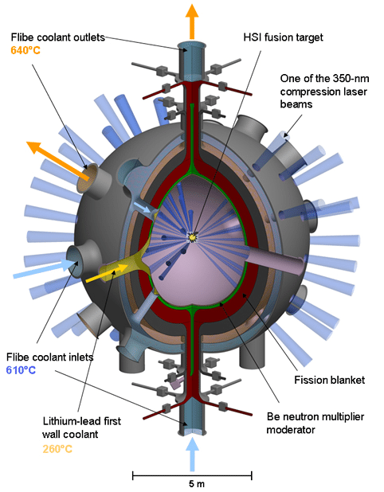
Fusion Research-Grade Reactors
Alternative technology uses powerful lasers
Notes:
Atomic number: Z = number of protons that equals number of electrons
Nucleus: made of protons and neutrons

Slide 20
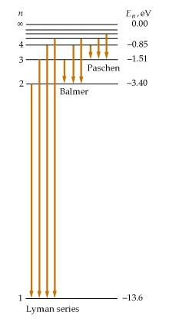
Practice Problem 1
Electrons of energy 12.2 eV are fired at hydrogen atoms in a gas discharge tube and excite hydrogen atoms from their ground state to some excited state. Determine the wavelengths (in nm) of the radiation that can be emitted by the hydrogen gas atoms. Sketch an energy level diagram and label the transitions that result in the emitted photons by the hydrogen gas.
From 12.2 eV, maximum level that can be excited is $n=3,$ since
$E_{3}=\frac{E_{0}}{3^{2}} = \frac{−13.6}{9}=−1.51$eV $<13.6−12.2$
Hence may have transitions $n: 3→2, 3→1, 2→1$
Using
These correspond to wavelengths:
656.1 nm, 102.6 nm, 121.6 nm.
$$\frac{1}{λ}=1.096776×{10}^{−2}\left(\frac{1}{n_{2}^{2}}−\frac{1}{n_{1}^{2}}\right){\text{nm}}^{−1}$$

Slide 21
Practice Problem 1
The wavelength of the emission lines produced by the hydrogen atom are given by the formula
$$\frac{1}{λ}=1.096776×{10}^{−2}\left(\frac{1}{n_{2}^{2}}−\frac{1}{n_{1}^{2}}\right){\text{nm}}^{−1}$$
What are the wavelengths of the first two lines in the Balmer series that involve transitions to level $n =$ 2? Answer: 656.5 nm, 486.3 nm
Calculate the energy in eV required to raise an electron from the ground state to level 2. Answer: -10.2 eV (10.2 eV required)
Electrons of energy 12.2 eV are fired at hydrogen atoms in a gas discharge tube and excite hydrogen atoms from their ground state to some excited state. Determine the wavelengths (in nm) of the radiation that can be emitted by the hydrogen gas atoms. Sketch an energy level diagram and label the transitions that result in the emitted photons by the hydrogen gas. Answer: 102.6 nm, 656.1 nm, 121.6 nm.

Slide 22
Practice Problem 2
Substitute the missing atomic number, mass numbers, and/or symbols in the following nuclear reactions and radioactive decays:
$${}_{27}^{59}{Co}+{}_{2}^{4}{He}→{}_{29}^{61}{Cu} + ?$$
$$?+ {}_{29}^{63}{Cu}→{}_{30}^{64}{Zn} +\text{n}$$
$$\text{p}+ {}_{1}^{3}H→{}_{1}^{2}H +\text{?}$$
$$\text{?}+ {}_{92}^{235}U→{}_{37}^{93}{Rb} +{}_{55}^{141}{Cs+2n}$$
$$\text{n}+ {}_{92}^{238}U→{}_{93}^{239}{Np} +{\text{e}}^{−}+ ?$$
$${}_{93}^{239}{Np}→{}_{94}^{239}{Pu} + ? +\overline{ ν}$$
$${}_{8}^{15}O→{}_{7}^{15}N + ? + ν$$
$${}_{78}^{175}{Pt}→{}_{76}^{171}{Os} + ?$$

Slide 23
Practice Problem 2
Substitute the missing atomic number, mass numbers, and/or symbols in the following nuclear reactions and radioactive decays:
$${}_{27}^{59}{Co}+{}_{2}^{4}{He}→{}_{29}^{61}{Cu} + ?$$
$$? + {}_{29}^{63}{Cu}→{}_{30}^{64}{Zn} +\text{n}$$
$$\text{p}+ {}_{1}^{3}H→{}_{1}^{2}H + ?$$
$$\text{?}+ {}_{92}^{235}U→{}_{37}^{93}{Rb} +{}_{55}^{141}{Cs+2n}$$
$$\text{n}+ {}_{92}^{238}U→{}_{93}^{239}{Np} +{\text{e}}^{−} + ?$$
$${}_{93}^{239}{Np}→{}_{94}^{239}{Pu} + ?+\overline{ ν}$$
$${}_{8}^{15}O→{}_{7}^{15}N + ? + ν$$
$${}_{78}^{175}{Pt}→{}_{76}^{171}{Os} + ?$$

Slide 24
Practice Problem 2
Substitute the missing atomic number, mass numbers, and/or symbols in the following nuclear reactions and radioactive decays:
$${}_{27}^{59}{Co}+{}_{2}^{4}{He}→{}_{29}^{61}{Cu} +2n$$
$${}_{1}^{2}H+ {}_{29}^{63}{Cu}→{}_{30}^{64}{Zn} +\text{n}$$
$$\text{p}+ {}_{1}^{3}H→{}_{1}^{2}H+{}_{1}^{2}H$$
$$\text{n}+ {}_{92}^{235}U→{}_{37}^{93}{Rb} +{}_{55}^{141}{Cs+2n}$$
$$\text{n}+ {}_{92}^{238}U→{}_{93}^{239}{Np} +{\text{e}}^{−}+{\overline{ν}}_{e}$$
$${}_{93}^{239}{Np}→{}_{94}^{239}{Pu} +β^{−}+\overline{ ν}$$
$${}_{8}^{15}O→{}_{7}^{15}N +β^{+}+ ν$$
$${}_{78}^{175}{Pt}→{}_{76}^{171}{Os} +{}_{2}^{4}{He}$$

Slide 25
Practice Problem 3
A building on a military base has accidentally been contaminated by 5.0 kg of radioactive ${}_{38}^{90}{Sr}$ (Strontium-90), which has an atomic mass of 89.9077 u and a half-life of 29.1 years. Strontium-90 is particularly dangerous because it substitutes for calcium in bones. Assuming that the safe decay rate is defined at 10.0 decays/min, for how long will the building be unsafe?
First work out number of ⁹⁰Sr atoms:
$$N_{0}=\frac{5}{90×1.7×{10}^{−27}}≈3.3×{10}^{25}$$
Then find e-folding time: $τ=\frac{t_{1/2}}{ln⁡(2)}≈42.0$ yr $=1.4×{10}^{9}$ s
Finally, use rate $R=−\dot{N}=−N_{0}\frac{d\left(\exp\left(−\frac{t}{τ}\right)\right)}{dt}=\frac{N_{0}}{τ}$ $\exp\left(−\frac{t}{τ}\right)$
Set rate to R=0.17 cts s⁻¹ and rearrange: $t=−τ ln⁡(\frac{Rτ}{N_{0}})≈1660$ yr

Slide 26
Practice Problem 3
A building on a military base has accidentally been contaminated by 5.0 kg of radioactive ${}_{38}^{90}{Sr}$ (Strontium-90), which has an atomic mass of 89.9077 u and a half-life of 29.1 years. Strontium-90 is particularly dangerous because it substitutes for calcium in bones. Assuming that the safe decay rate is defined at 10.0 decays/min, for how long will the building be unsafe?
Answer: 1662 years

